Slide 1
ECONOMICS
Twelfth Edition, Global Edition
Chapter 7
Global Markets in Action

Slide 2
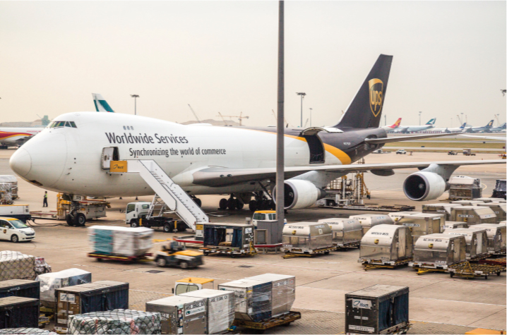
Chapter Outline and Learning Objectives
7.1 Explain how markets work with international trade
7.2 Identify the gains from international trade and its winners and losers
7.3 Explain the effects of international trade barriers
7.4 Explain and evaluate arguments used to justify restricting international trade
Notes:
Notes and teaching tips: 3, 4, 5, 21, 25, 41, 42, 45, 45, and 49.
To advance to the next slide, click anywhere on the full screen figure.
Applying the principles of economics to interpret and understand the news is a major goal of the principles course. You can encourage your students in this activity by using the two features: Economics in the News and Economics in Action.
(1) Before each class, scan the news and select two or three headlines that are relevant to your session today. There is always something that works. Read the headline and ask for comments, interpretation, discussion. Pose questions arising from it that motivate today’s class. At the end of the class, return to the questions and answer them with the tools you’ve been explaining.
(2) Once or twice a semester, set an assignment, for credit, with the following instructions:
(a) Find a news article about an economic topic that you find interesting.
(b) Make a short bullet-list summary of the article.
(c) Write and illustrate with appropriate graphs an economic analysis of the key points in the article.
Use the Economics in the News features in your textbook as models.

Slide 3
How Global Markets Work (1 of 10)
Because we trade with people in other countries, the goods and services that we can buy and consume are not limited by what we can produce.
Imports are the goods and services that we buy from people in other countries.
Exports are the goods and services we sell to people in other countries.
Notes:
The key facts are worth emphasizing: enormous growth in volume of trade and huge two way trade in manufactures.
Explain that the balance of trade along with the international borrowing and lending that finances it results from spending and saving decisions in the United States and the rest of the world and is independent of the forces that generate the volume of trade, which this chapter covers. (In a micro course, note that this topic gets covered in macro. In a macro course, note that this topic comes in the next chapter.)

Slide 4
How Global Markets Work (2 of 10)
International Trade Today
Global trade today is enormous.
In 2013, global exports and imports were $23 trillion, which is one third of the value of global production.
In 2013, total U.S exports were $2.3 trillion, which is about 14 percent of the value of U.S. production.
In 2013, total U.S. imports were $2.7 trillion, which is about 17 percent of the value of total U.S. expenditure.
Services were about 33 percent of total U.S. exports and about 20 percent of total U.S. imports.
Notes:
Classroom activity
Check out Economics in Action: We Trade Services for Oil

Slide 5
How Global Markets Work (3 of 10)
What Drives International Trade?
The fundamental force that generates trade between nations is comparative advantage.
The basis for comparative advantage is divergent opportunity costs between countries.
National comparative advantage is the ability of a nation to perform an activity or produce a good or service at a lower opportunity cost than any other nation.
Notes:
Note that comparative advantage and its basis is explained in Chapter 2. Remind the students and send them back to that chapter for a quick review.
There is an enormously rich heritage of stories, parables, fables, and satires that you can use to enliven your classes on this topic. The following fable, inspired by James Ingram, International Economic Problems, John Wiley, 1970, is a powerful way to begin. Make up your own version with local flavor and embellishment.
Adam Blackbox announces that he has discovered an amazing way to produce low-price, high-quality automobiles. He sets up a plant on a large tract of land along the coast of Massachusetts, hires 10,000 employees, swears them to secrecy, and begins delivering his low-price, high-quality autos to the nation’s showrooms. Adam Blackbox is hailed as an American industrial hero. Blackbox Enterprises floats stock and Wall Street booms.
Consumers love Adam Blackbox. His automobiles are better and cheaper than those they could buy before he came along. Automakers hate him, but their attempts to pass laws to restrict his operations fail. The president and congressional leaders explain that economic adjustment is an inevitable consequence of technological advance. And Adam Blackbox’s new technology for delivering low-price, high-quality automobiles is clearly part of the process of achieving greater prosperity for all.
(continued on slide 62 )
You can easily segue from this story to the analysis of the United States and China.

Slide 6
How Global Markets Work (4 of 10)
The opportunity cost of producing a T-shirt is lower in China than in the United States, so China has a comparative advantage in producing T-shirts.
The opportunity cost of producing an airplane is lower in the United States than in China, so the United States has a comparative advantage in producing airplanes.
Both countries can reap gains from trade by specializing in the production of the good in which they have a comparative advantage and then trading.
Both countries are better off.

Slide 7
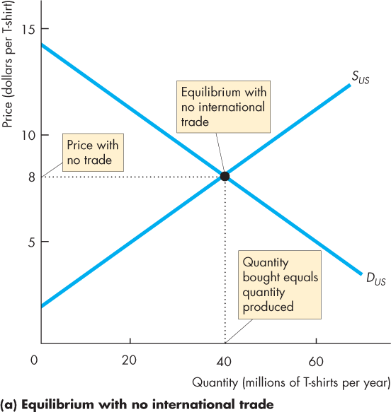
How Global Markets Work (5 of 10)
Why the United States Imports T-Shirts
Figure 7.1(a) shows U.S. demand and U.S. supply with no international trade.
The price of a T-shirt is $8.
U.S. firms produce 40 million T-shirts a year and U.S. consumers buy 40 million T-shirts a year.

Slide 8
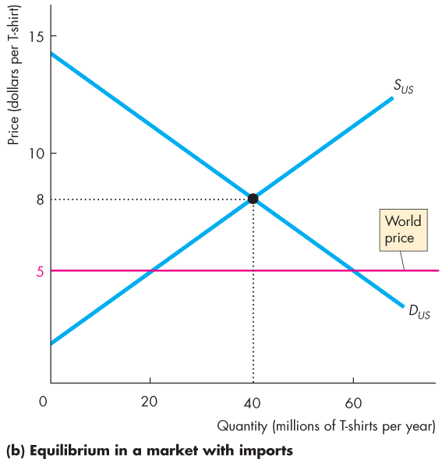
How Global Markets Work (6 of 10)
Figure 7.1(b) shows the market in the United States with international trade.
World demand and world supply of T-shirts determine the world price of a T-shirt at $5.
The world price is less than $8, so the rest of the world has a comparative advantage in producing T-shirts.

Slide 9
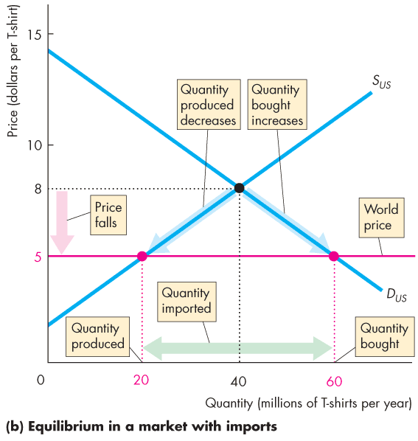
How Global Markets Work (7 of 10)
With international trade, the price of a T-shirt in the United States falls to $5.
At $5 a T-shirt, U.S. garment makers cut production to 20 million T-shirts a year.
At $5 a T-shirt, U.S. consumers buy 60 million T-shirts a year.
The United States imports 40 million T-shirts a year.

Slide 10
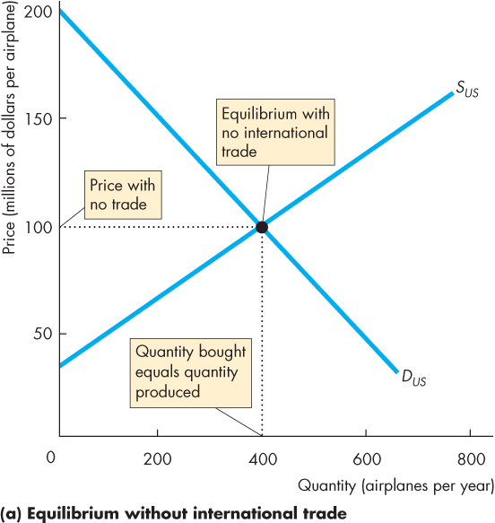
How Global Markets Work (8 of 10)
Why the United States Exports Airplanes
Figure 7.2(a) shows U.S. demand and U.S. supply with no international trade.
The price of an airplane is $100 million.
Boeing produces 400 airplanes a year and U.S. airlines buy 400 a year.

Slide 11
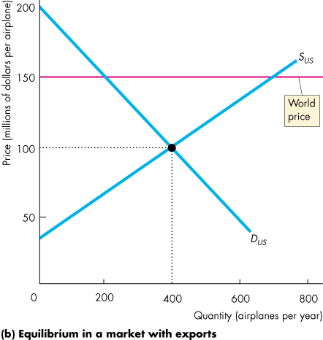
How Global Markets Work (9 of 10)
Figure 7.2(b) shows the market in the United States with international trade.
World demand and world supply of airplanes determine the world price of an airplane at $150 million.
The world price exceeds $100 million, so the United States has a comparative advantage in producing airplanes.

Slide 12
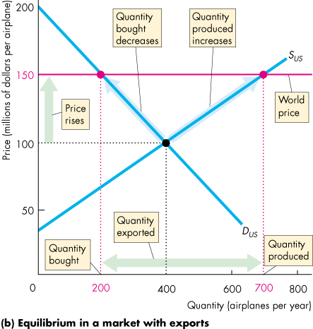
How Global Markets Work (10 of 10)
With international trade, the price of an airplane in the United States rises to $150 million.
At $150 million, U.S. airlines buy 200 jets a year.
At $150 million, Boeing produces 700 airplanes a year.
The United States exports 500 airplanes a year.

Slide 13
Winners, Losers, and the Net Gain from Trade (1 of 7)
International trade lowers the price of an imported good and raises the price of an exported good.
Buyers of imported goods benefit from lower prices and sellers of exported goods benefit from higher prices.
But some people complain about international competition: not everyone gains.
Who wins and who loses from free international trade?

Slide 14
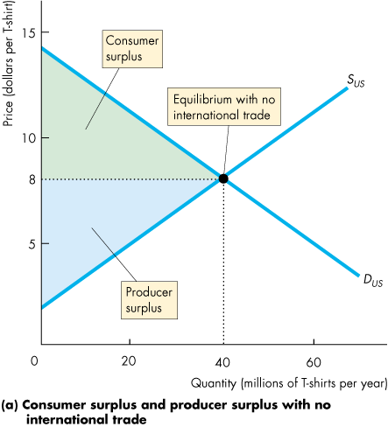
Winners, Losers, and the Net Gain from Trade (2 of 7)
Gains and Losses from Imports
Figure 7.3(a) shows the market in the United States with no international trade.
Total surplus from T-shirts is the sum of the consumer surplus and the producer surplus.

Slide 15
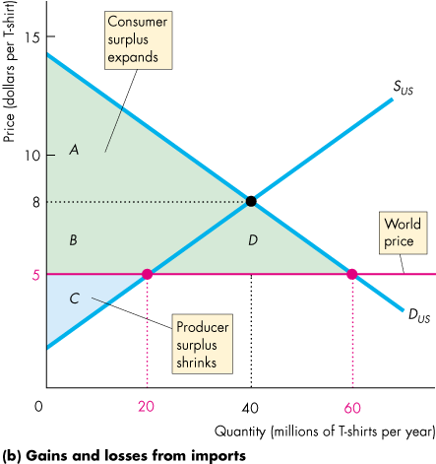
Winners, Losers, and the Net Gain from Trade (3 of 7)
Figure 7.3(b) shows the market in the United States with international trade.
The world price of a T-shirt is $5.
Consumer surplus expands from area A to the area A + B + D.
Producer surplus shrinks from area B + C to the area C.

Slide 16
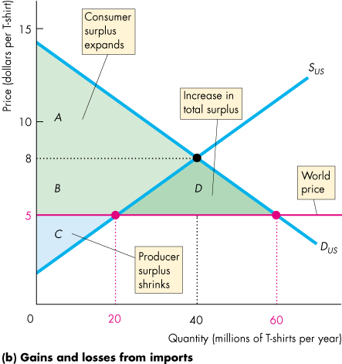
Winners, Losers, and the Net Gain from Trade (4 of 7)
The area B is transferred from producers to consumers.
Area D is an increase in total surplus.
Area D is the net gain from imports.

Slide 17
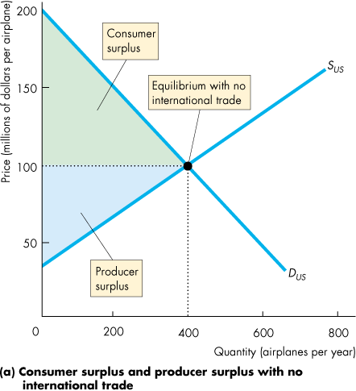
Winners, Losers, and the Net Gain from Trade (5 of 7)
Gains and Losses from Exports
Figure 7.4(a) shows the market in the United States with no international trade.
Total surplus from airplanes is the sum of the consumer surplus and the producer surplus.

Slide 18
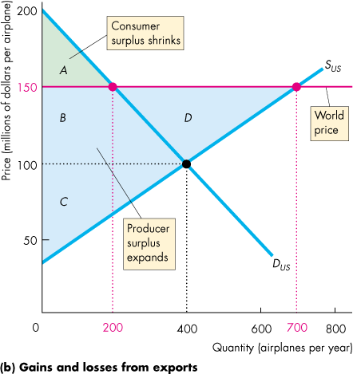
Winners, Losers, and the Net Gain from Trade (6 of 7)
Figure 7.4(b) shows the market in the United States with international trade.
The world price of an airplane is $150 million.
Consumer surplus shrinks to the area A.
Producer surplus expands to the area C + B + D.

Slide 19
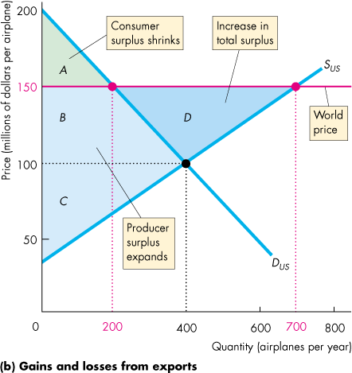
Winners, Losers, and the Net Gain from Trade (7 of 7)
The area B is transferred from consumers to producers.
Area D is an increase in total surplus.
Area D is the net gain from exports.

Slide 20
International Trade Restrictions (1 of 22)
Governments restrict international trade to protect domestic producers from competition.
Governments use four sets of tools:
Tariffs
Import quotas
Other import barriers
Export subsidies

Slide 21
International Trade Restrictions (2 of 22)
Tariffs
A tariff is a tax on a good that is imposed by the importing country when an imported good crosses its international boundary.
For example, the government of India imposes a 100 percent tariff on wine imported from the United States.
So when an Indian wine merchant imports a $10 bottle of California wine, the merchant pays the Indian government $10 import duty.
Notes:
The formal analysis in this section is straightforward. You might want to draw parallels between tariffs and taxes.
Classroom activity
Check out Economics in Action: U.S. Tariffs Almost Gone
Check out Economics in the News: The Changing Market for Coat Hangers

Slide 22
International Trade Restrictions (3 of 22)
The Effects of a Tariff
With free international trade, the world price of a T-shirt is $5 and the United States imports 40 million T-shirts a year.
Imagine that the United States imposes a tariff of $2 on each T-shirt imported.
The price of a T-shirt in the United States rises by $2.
Figure 7.5 shows the effect of the tariff on the market for T-shirts in the United States.

Slide 23
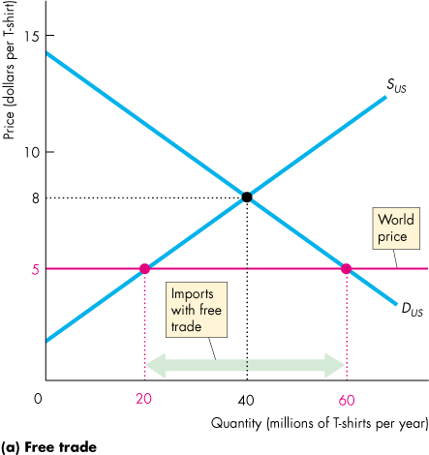
International Trade Restrictions (4 of 22)
Figure 7.5(a) shows the market before the government imposes the tariff.
The world price of a T-shirt is $5.
With free international trade, the United States imports 40 million T-shirts a year.

Slide 24
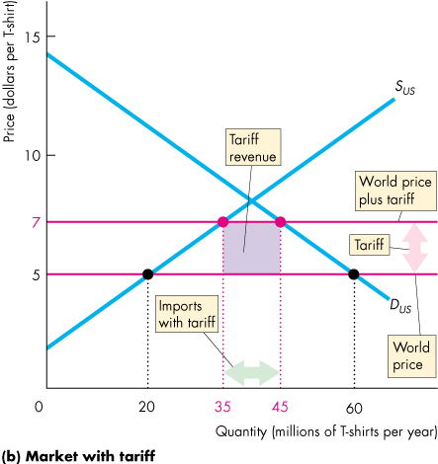
International Trade Restrictions (5 of 22)
Figure 7.5(b) shows the effect of a tariff on imports.
The tariff of $2 raises the price in the United States to $7 a T-shirt.
U.S. imports decrease to 10 million a year.
U.S. government collects the tariff revenue of $20 million a year.

Slide 25
International Trade Restrictions (6 of 22)
Winners, Losers, and Social Loss from a Tariff
When the U.S. government imposes a tariff on imported T-shirts:
U.S. consumers of T-shirts lose.
U.S. producers of T-shirts gain.
U.S. consumers lose more than U.S. producers gain.
Society loses: A deadweight loss arises.
Notes:
Classroom activity
Check out Economics in the News: Obstacles to Free Trade

Slide 26
International Trade Restrictions (7 of 22)
U.S. Consumers of T-Shirts Lose
U.S. buyers of T-shirts now pay a higher price (the world price plus the tariff), so they buy fewer T-shirts.
The combination of a higher price and a smaller quantity bought decreases consumer surplus.
The loss of consumer surplus is the loss to U.S. consumers from the tariff.

Slide 27
International Trade Restrictions (8 of 22)
U.S. Producers of T-Shirts Gain
U.S. garment makers can now sell T-shirts for a higher price (the world price plus the tariff), so they produce more T-shirts.
But the marginal cost of producing a T-shirt is less than the higher price, so the producer surplus increases.
The increased producer surplus is the gain to U.S. garment makers from the tariff.

Slide 28
International Trade Restrictions (9 of 22)
U.S. Consumers Lose More than U.S. Producers Gain
Consumer surplus decreases and producer surplus increases.
Which changes by more?
Figure 7.6 illustrates the change in total surplus.

Slide 29
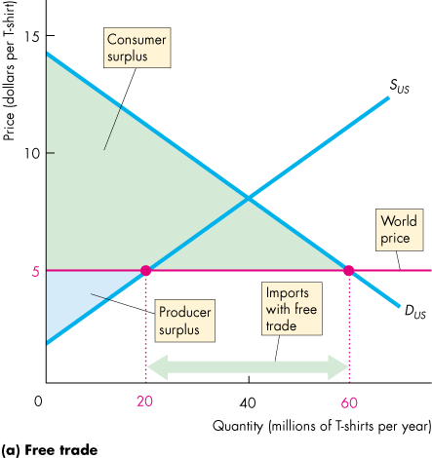
International Trade Restrictions (10 of 22)
Figure 7.6(a) shows the total surplus with free international trade.
The world price of a T-shirt is $5.
Imports are 40 million T-shirts a year.
Consumer surplus is the area of the green triangle.
Producer surplus is the area of the blue triangle.

Slide 30
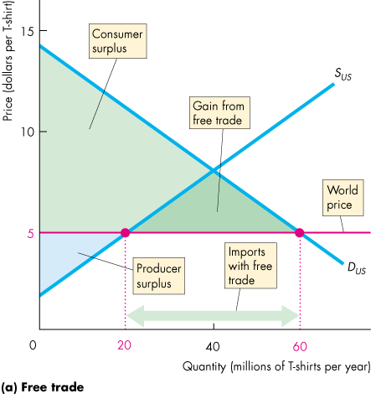
International Trade Restrictions (11 of 22)
The gains from trade is the area of the dark green triangle.
Total surplus is the sum of the green and blue areas.

Slide 31
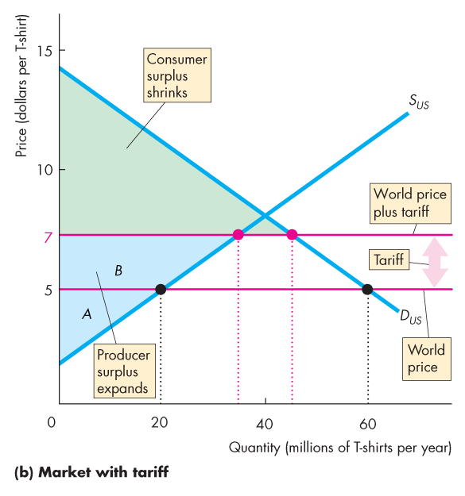
International Trade Restrictions (12 of 22)
Figure 7.6(b) shows the winners and losers from a tariff.
The $2 tariff is added to the world price, which increases the price in the United States to $7 a T-shirt.
The quantity of T-shirts produced in the United States increases and the quantity bought in the United States decreases.

Slide 32
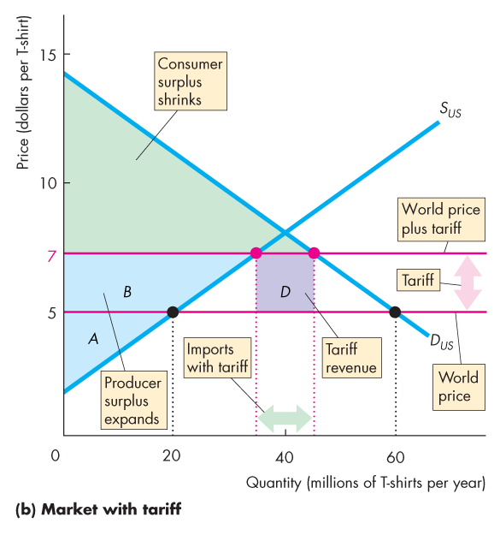
International Trade Restrictions (13 of 22)
Consumer surplus shrinks to the green area.
Producer surplus expands to the blue area.
Area B is a transfer from consumer surplus to producer surplus.
Imports decrease.
Tariff revenue equals area D: Imports of T-shirts multiplied by $2 a T-shirt.

Slide 33
International Trade Restrictions (14 of 22)
Society Loses: A Deadweight Loss Arises
Some of the loss of consumer surplus is transferred to producers and some is transferred to the government as tariff revenue.
But the increase in production costs and the loss from decreased imports is a social loss.

Slide 34
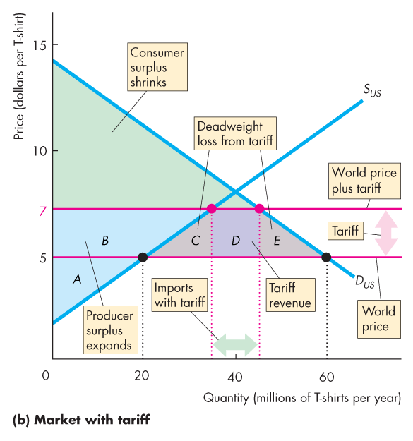
International Trade Restrictions (15 of 22)
The cost of producing a T-shirt in the United States increases and creates a social loss shown by area C.
The decrease in the quantity of imported T-shirts creates a social loss shown by area E.
The tariff creates a social loss (deadweight loss) equal to area C + E.

Slide 35
International Trade Restrictions (16 of 22)
Import Quotas
An import quota is a restriction that limits the maximum quantity of a good that may be imported in a given period.
For example, the United States imposes import quotas on food products such as sugar and bananas and manufactured goods such as textiles and paper.

Slide 36
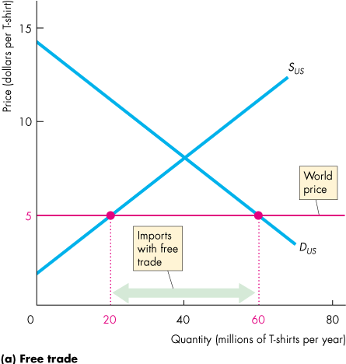
International Trade Restrictions (17 of 22)
The Effects of an Import Quota
Figure 7.7(a) shows the market before the government imposes an import quota on T-shirts.
The world price is $5.
The United States imports 40 million T-shirts a year.

Slide 37
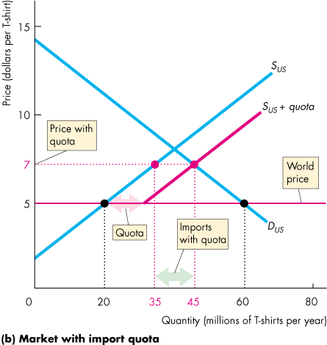
International Trade Restrictions (18 of 22)
Figure 7.7(b) shows the market with an import quota of 10 million T-shirts.
With the quota, the supply of T-shirts in the United States becomes S + quota.
The price rises to $7.
The quantity produced in the United States increases and the quantity bought decreases.
Imports decrease.

Slide 38
International Trade Restrictions (19 of 22)
Winners, Losers, and Social Loss from an Import Quota
When the U.S. government imposes an import quota on imported T-shirts:
U.S. consumers of T-shirts lose.
U.S. producers of T-shirts gain.
Importers of T-shirts gain.
Society loses: A deadweight loss arises.
Figure 7.8 illustrates the winners and losers with an import quota.

Slide 39
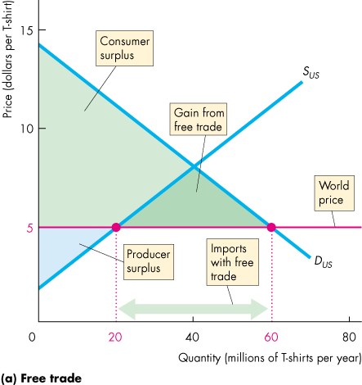
International Trade Restrictions (20 of 22)
Figure 7.8(a) shows the total surplus with free international trade.
Total surplus is maximized.

Slide 40
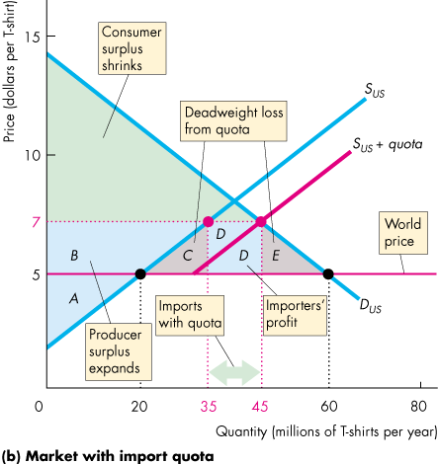
International Trade Restrictions (21 of 22)
The import quota raises the price of a T-shirt to $7 and decreases imports.
Area B is transferred from consumer surplus to producer surplus.
Importers’ profit is the sum of the two areas D.
The area C + E is the loss of total surplus—a deadweight loss created by the quota.

Slide 41
International Trade Restrictions (22 of 22)
Other Import Barriers
Thousands of detailed health, safety, and other regulations restrict international trade.
Export Subsidies
An export subsidy is a payment made by the government to a domestic producer of an exported good.
Export subsidies bring gains to domestic producers, but they result in overproduction in the domestic economy and underproduction in the rest of the world and so create a deadweight loss.
Notes:
Classroom activity
Check out Economics in Action: Self-Interest Beats the Social Interest

Slide 42
The Case Against Protection (1 of 11)
Despite the fact that free trade promotes prosperity for all countries, trade is restricted.
Seven arguments for restricting international trade are that protecting domestic industries from foreign competition
Helps an infant industry grow.
Counteracts dumping.
Saves domestic jobs.
Allows us to compete with cheap foreign labor.
Penalizes lax environmental standards.
Prevents rich countries from exploiting developing countries.
Reduces offshore outsourcing that sends U.S. jobs abroad.
Notes:
Unrestricted international trade benefits all the countries involved with trade.
Emphasize the key benefits from unrestricted international trade:
The gains from international trade arise from the diversity of opportunity costs of production across countries. The source of prosperity in free trade arises from each country generating gains from specialization in their comparative advantage, minimizing its own opportunity cost of production, and sharing in each of the other country’s gains.
Both exporting and importing domestic industries benefit from free trade. Free trade liberates each country’s consumption possibilities from the bonds of their own production possibilities frontier, enabling the consumers in both the importing and exporting country to enjoy consumption bundles of goods and services that would be unobtainable without trade.
Restrictions on international trade hurt the importing firms, the consumers of imports, the domestic exporting firms, and even the non-exporting firms. Protecting domestic industry from international competition backfires: i) it increases the relative price that other countries pay for domestically produced goods and services that are exported; ii) it raises the price of the imported goods consumed by domestic consumers; and iii) it lowers the income of producers of the goods for which the country has a comparative advantage in production by more than the increase in the incomes of those industries that gain from trade restrictions. Together, these influences decrease the total demand for domestic goods and services in the country imposing trade restrictions by more than the increase in demand for those domestic goods and services in industries for which the country does not have a comparative advantage.

Slide 43
The Case Against Protection (2 of 11)
Helps an Infant Industry to Grow
Comparative advantages change with on-the-job experience called learning-by-doing.
When a new industry or a new product is born—an infant industry—it is not as productive as it will become with experience.
It is argued that such an industry should be protected from international competition until it can stand alone and compete.
Learning-by-doing is a powerful engine of productivity growth, but this fact does not justify protection.

Slide 44
The Case Against Protection (3 of 11)
Counteracts Dumping
Dumping occurs when a foreign firm sells its exports at a lower price than its cost of production.
This argument does not justify protection because
It is virtually impossible to determine a firm’s costs.
It is hard to think of a global monopoly, so even if all domestic firms are driven out, alternatives would still exist.
If the market is truly a global monopoly, it is better to regulate the monopoly rather than restrict trade.

Slide 45
The Case Against Protection (4 of 11)
Saves Domestic Jobs
The idea that buying foreign goods costs domestic jobs is wrong.
Imports destroy some jobs but create jobs for retailers that sell the imported goods and for firms that service these goods.
Free trade also increases foreign incomes and enables foreigners to buy more domestic production.
Protection to save particular jobs is very costly.
Notes:
[Continuing the story of Adam Blackbox.]
The press becomes increasingly curious about what is going on in the giant New England auto plant. Investigative journalists create endless hours of speculative television programming on the amazing new technology. Then a tabloid journalist with a big checkbook finds a worker who is willing to talk. Adam Blackbox's secret is revealed. Nothing is produced at the plant. Adam Blackbox is a trader, not a producer. He buys grain from American farmers, exports it to Japan, and imports automobiles from Japan.
His secret revealed, Adam Blackbox is hauled before Congressional committees on fair trade and denounced as an evil destroyer of American jobs. The president makes a special State of the Union speech in which he denounces Adam Blackbox, praises a vigilant press for saving Americans from the threat of cheap foreign labor, and announces a new budget initiative that will spend $50 billion on research in technologies to produce low cost, high-quality automobiles.
The gains from trade are like a technological advance. Adam Blackbox expanded the nation’s consumption possibilities just like a technological advance might have done. But he didn’t expand production possibilities and save American jobs.
Use this fable to generate a classroom discussion of questions such as:
Why did the president and Congress accept Adam Blackbox when they thought he had expanded production possibilities but not when they discovered that he had “only” expanded consumption possibilities?

Slide 46
The Case Against Protection (5 of 11)
Allows Us to Compete with Cheap Foreign Labor
The idea that a high-wage country cannot compete with a low-wage country is wrong.
Low-wage labor is less productive than high-wage labor.
And wages and productivity tell us nothing about the source of gains from trade, which is comparative advantage.

Slide 47
The Case Against Protection (6 of 11)
Penalizes Lax Environmental Standards
The idea that protection is good for the environment is wrong.
Free trade increases incomes and poor countries have lower environmental standards than rich countries.
These countries cannot afford to spend as much on the environment as a rich country can and sometimes they have a comparative advantage at doing “dirty” work, which helps the global environment achieve higher environmental standards.

Slide 48
The Case Against Protection (7 of 11)
Prevents Rich Countries from Exploiting Developing Countries
By trading with people in poor countries, we increase the demand for the goods that these countries produce and increase the demand for their labor.
The increase in the demand for labor raises their wage rate.
Trade can expand the opportunities and increase the incomes of people in poor countries.
Notes:
Does free trade exploit workers in developing countries? Students might be somewhat familiar with the terminology of “exploitation”. Have the students think about what “exploitation” means in the context of voluntary trade. If I benefit from someone I trade with, did I exploit them? Did they exploit me? If trade is voluntary, how did I manage to exploit the person whom I traded with? Is it because I am smarter than the other person? This seems to be the condescending assumption of those who talk about exploitation of workers in developing countries. Indeed, representatives from many developing countries do not see trade as exploitation, but rather see it as a way to improve standards of living. When these representatives are upset at WTO meetings, it is usually about the trade restrictions rich countries place on imports from developing countries keeping developing countries poor.

Slide 49
The Case Against Protection (8 of 11)
Reduces Offshore Outsourcing that Sends U.S. Jobs Abroad
Offshore outsourcing occurs when a firm in the United States buys finished goods, components, or services from firms in other countries.
Despite the gain from specialization and trade that offshore outsourcing brings, many people believe that it also brings costs that eat up the gains. Why?
Americans, on average, gain from offshore outsourcing, but some people lose.
The losers are those who have invested in the human capital to do a specific job that has now gone offshore.
Notes:
Classroom activity
Check out At Issue: Is Offshore Outsourcing Bad or Good for America?

Slide 50
The Case Against Protection (9 of 11)
Why Is International Trade Restricted?
The key reason why international trade restrictions are popular in the United States and most other developed countries is an activity called rent seeking.
Rent seeking is lobbying and other political activity that seeks to capture the gains from trade.
You’ve seen that free trade benefits consumers but shrinks the producer surplus of firms that compete in markets with imports.

Slide 51
The Case Against Protection (10 of 11)
Those who gain from free trade are the millions of consumers of low-cost imports.
But the benefit per individual consumer is small.
Those who lose are the producers of import-competing items.
Compared to the millions of consumers, there are only a few thousand producers.
These producers have a strong incentive to incur the expense of lobbying for a tariff and against free trade.

Slide 52
The Case Against Protection (11 of 11)
The gain from free trade for any one person is too small for that person to spend much time or money on a political organization to lobby for free trade.
Each group weighs benefits against costs and chooses the best action for themselves.
But the group against free trade will undertake more political lobbying than will the group for free trade.

