Slide 1
ECONOMICS
Twelfth Edition, Global Edition
Chapter 5
Efficiency and
Equity

Slide 2
Chapter Outline and Learning Objectives
5.1 Describe the alternative methods for allocating scarce resources
5.2 Explain the connection between demand and marginal benefit and define consumer surplus; and explain the connection between supply and marginal cost and define producer surplus
5.3 Explain the conditions under which markets are efficient and inefficient
5.4 Explain the main ideas about fairness and evaluate claims that markets result in unfair outcomes
Notes:
Notes and teaching tips: 3, 18, 20, 22, 31, 37, 38, 40, 41, 43, 55, and 61.
To advance to the next slide, click anywhere on the full screen figure.
Applying the principles of economics to interpret and understand the news is a major goal of the principles course. You can encourage your students in this activity by using the two features: Economics in the News and Economics in Action.
(1) Before each class, scan the news and select two or three headlines that are relevant to your session today. There is always something that works. Read the headline and ask for comments, interpretation, discussion. Pose questions arising from it that motivate today’s class. At the end of the class, return to the questions and answer them with the tools you’ve been explaining.
(2) Once or twice a semester, set an assignment, for credit, with the following instructions:
(a) Find a news article about an economic topic that you find interesting.
(b) Make a short bullet-list summary of the article.
(c) Write and illustrate with appropriate graphs an economic analysis of the key points in the article.
Use the Economics in the News features in your textbook as models.

Slide 3
Resource Allocation Methods (1 of 9)
Scare resources might be allocated by
Market price
Command
Majority rule
Contest
First-come, first-served
Lottery
Personal characteristics
Force
How does each method work?
Notes:
Make the discussion of this topic concrete and real. Come to class with something of low but positive value that you’re going to end up giving to a student. How will the decision about who gets the object be made?
Make the class debate the pros and cons of each of the methods.
If you did the demand curve experiment, remind the class that market price allocated the bottles of water.
The question now is does market price do a good job?

Slide 4
Resource Allocation Methods (2 of 9)
Market Price
When a market allocates a scarce resource, the people who get the resource are those who are willing to pay the market price.
Most of the scarce resources that you supply get allocated by market price.
You sell your labor services in a market, and you buy most of what you consume in markets.
For most goods and services, the market turns out to do a good job.

Slide 5
Resource Allocation Methods (3 of 9)
Command
Command system allocates resources by the order (command) of someone in authority.
For example, if you have a job, most likely someone tells you what to do. Your labor time is allocated to specific tasks by command.
A command system works well in organizations with clear lines of authority but badly in an entire economy.

Slide 6
Resource Allocation Methods (4 of 9)
Majority Rule
Majority rule allocates resources in the way the majority of voters choose.
Societies use majority rule for some of their biggest decisions.
For example, tax rates that allocate resources between private and public use and tax dollars between competing uses such as defense and health care.
Majority rule works well when the decision affects lots of people and self-interest must be suppressed to use resources efficiently.

Slide 7
Resource Allocation Methods (5 of 9)
Contest
A contest allocates resources to a winner (or group of winners).
The most obvious contests are sporting events but they occur in other arenas:
For example, The Oscars are a type of contest.
A contest works well when the efforts of the “players” are hard to monitor and reward directly.

Slide 8
Resource Allocation Methods (6 of 9)
First-Come, First-Served
First-come, first-served allocates resources to those who are first in line.
Casual restaurants use first-come, first served to allocate tables. Supermarkets also uses first-come, first-served at checkout.
First-come, first-served works best when scarce resources can serve just one person at a time in a sequence.

Slide 9
Resource Allocation Methods (7 of 9)
Lottery
Lotteries allocate resources to those with the winning number, who draw the lucky cards, or who come up lucky on some other gaming system.
State lotteries and casinos reallocate millions of dollars worth of goods and services each year.
But lotteries are more widespread. For example, they are used to allocate landing slots at some airports and places in some marathons.
Lotteries work well when there is no effective way to distinguish among potential users of a scarce resource.

Slide 10
Resource Allocation Methods (8 of 9)
Personal Characteristics
Personal characteristics allocate resources to those with the “right” characteristics.
For example, people choose marriage partners on the basis of personal characteristics.
But this method gets used in unacceptable ways: allocating the best jobs to white males and discriminating against minorities and women.

Slide 11
Resource Allocation Methods (9 of 9)
Force
Force plays a role in allocating resources.
For example, war has played an enormous role historically in allocating resources.
Theft, taking property of others without their consent, also plays a large role.
But force provides an effective way of allocating resources—for the state to transfer wealth from the rich to the poor and establish the legal framework in which voluntary exchange can take place in markets.

Slide 12
Benefit, Cost, and Surplus (1 of 25)
Demand, Willingness to Pay, and Value
Value is what we get, price is what we pay.
The value of one more unit of a good or service is its marginal benefit.
We measure value as the maximum price that a person is willing to pay.
But willingness to pay determines demand.
A demand curve is a marginal benefit curve.

Slide 13
Benefit, Cost, and Surplus (2 of 25)
Individual Demand and Market Demand
The relationship between the price of a good and the quantity demanded by one person is called individual demand.
The relationship between the price of a good and the quantity demanded by all buyers in the market is called market demand.
Figure 5.1 on the next slide shows the connection between individual demand and market demand.

Slide 14
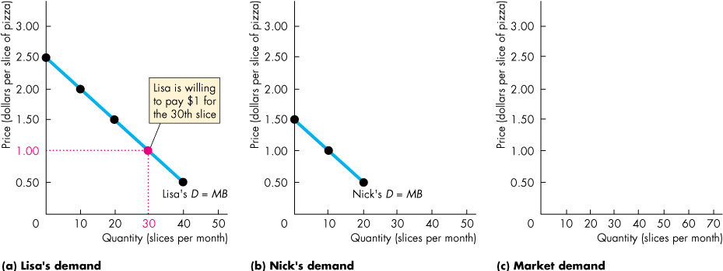
Benefit, Cost, and Surplus (3 of 25)
Lisa and Nick are the only buyers in the market for pizza.
At $1 a slice, the quantity demanded by Lisa is 30 slices.

Slide 15
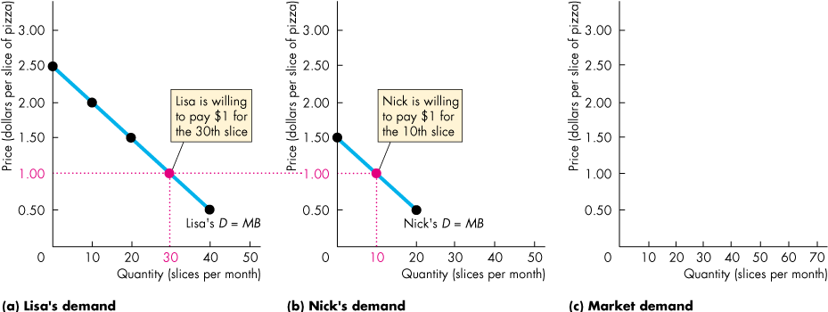
Benefit, Cost, and Surplus (4 of 25)
Lisa and Nick are the only buyers in the market for pizza.
At $1 a slice, the quantity demanded by Nick is 10 slices.

Slide 16
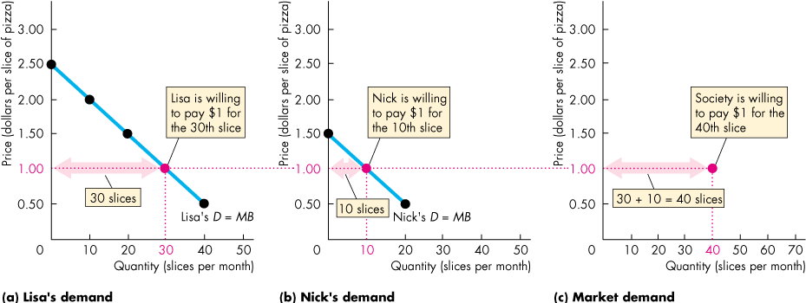
Benefit, Cost, and Surplus (5 of 25)
At $1 a slice, the quantity demanded by Lisa is 30 slices and by Nick is 10 slices.
The quantity demanded by all buyers is 40 slices.

Slide 17
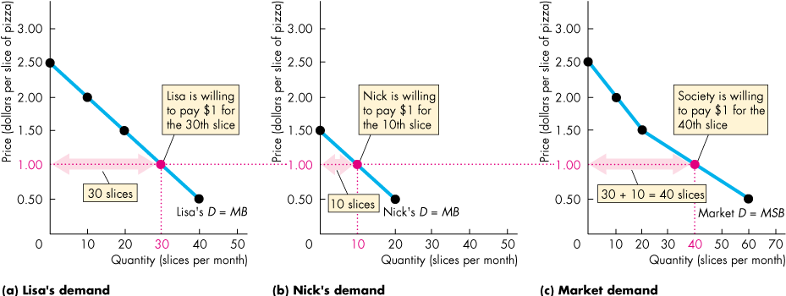
Benefit, Cost, and Surplus (6 of 25)
The market demand curve is the horizontal sum of the individual demand curves.

Slide 18
Benefit, Cost, and Surplus (7 of 25)
Consumer Surplus
Consumer surplus is the excess of the benefit received from a good over the amount paid for it.
We can calculate consumer surplus as the marginal benefit (or value) of a good minus its price, summed over the quantity bought.
It is measured by the area under the demand curve and above the price paid, up to the quantity bought.
Figure 5.2 on the next slide shows the consumer surplus from pizza when the market price is $1 a slice.
Notes:
The consumer surplus, producer surplus, and deadweight loss are all generally triangular in shape. Indeed, if you draw only linear demand and supply curves and do not make either curve vertical or horizontal, these surpluses and any deadweight loss are triangles. So, it is a good idea to remind your students of the formula for calculating the area of a triangle. Make sure to do several examples of the calculation for both consumer and producer surplus. Remind them that this area represents a dollar value. This reminder is especially useful when you quantify the deadweight losses created by monopolies, quotas, subsidies, etc. Many students just see the loss to society as a loss of jobs or less output, but you can create more intuition by putting the loss in dollar terms.

Slide 19
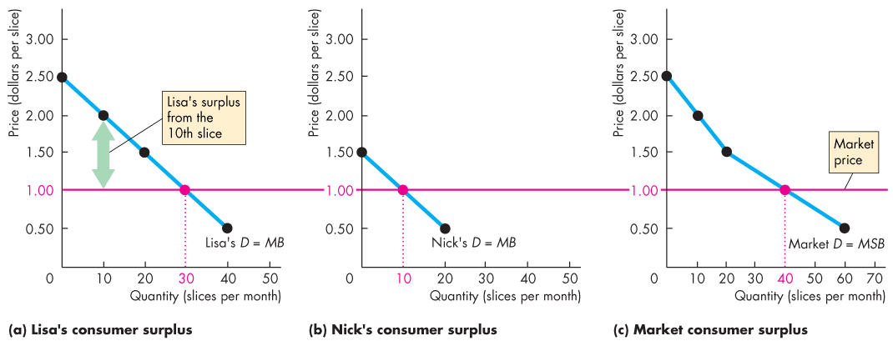
Benefit, Cost, and Surplus (8 of 25)
Lisa and Nick pay the market price, which is $1 a slice.
The value Lisa places on the 10th slice is $2.
Lisa’s consumer surplus from the 10th slice is the value minus the price, which is $1.

Slide 20
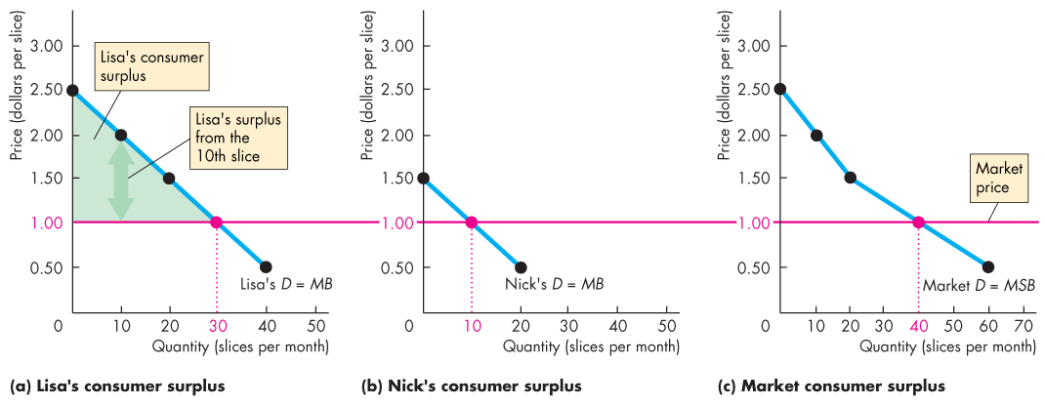
Benefit, Cost, and Surplus (9 of 25)
At $1 a slice, Lisa buys 30 slices.
So her consumer surplus is the area of the green triangle.
Notes:
The only thing that students sometimes get hung up on is the exact shape of the consumer surplus area—steps versus the complete triangle. The point isn’t worth laboring, but if students raise the matter and are curious, you might explain that we’re assuming that the good (pizza in the example) is finely divisible so that the whole triangle is (approximately) the consumer surplus.
[You will look at consumer surplus again if you cover marginal utility theory.]

Slide 21
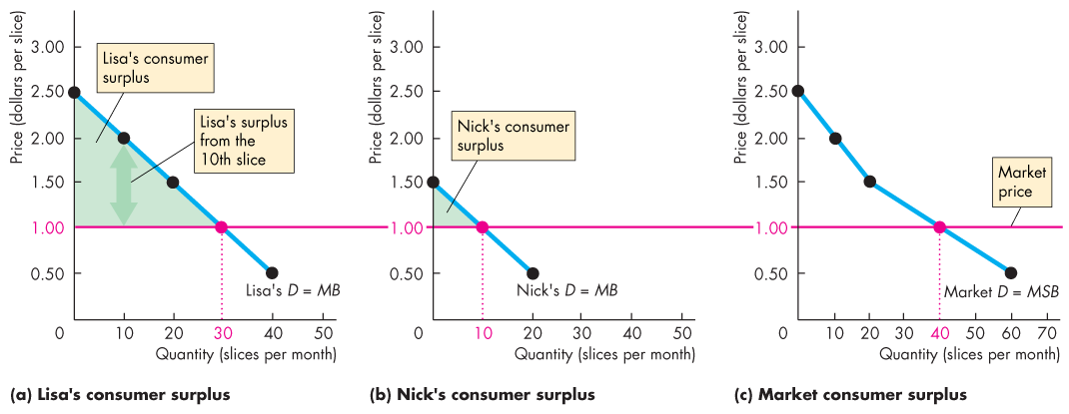
Benefit, Cost, and Surplus (10 of 25)
At $1 a slice, Nick buys 10 slices.
So his consumer surplus is the area of the green triangle.

Slide 22
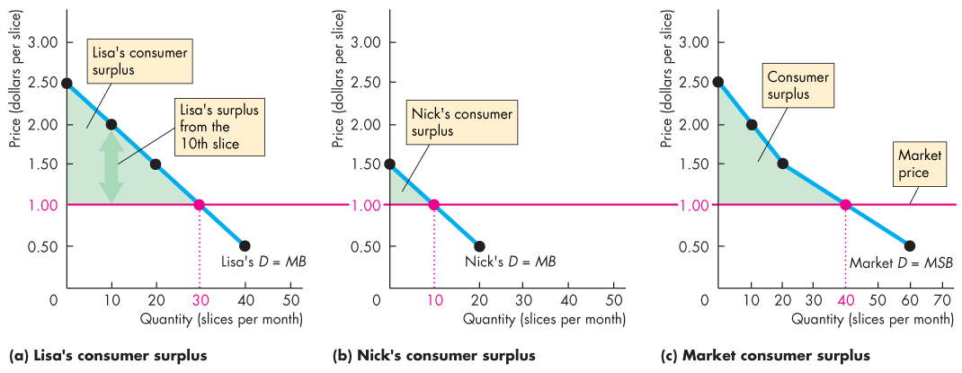
Benefit, Cost, and Surplus (11 of 25)
At $1 a slice, the consumer surplus for the economy is green area under the market demand curve above the market price, summed over the 40 slices bought.
Notes:
It always helps to use colored chalk, overheads, or PowerPoint slides when dividing up the demand-supply graph into producer surplus, consumer surplus, and deadweight loss. By using colored chalk or the other techniques, you can refer to area by color.
In the text and PPT slides, we use color consistently:
Consumer surplus is green
Producer surplus is blue
Total expenditure is blue
Total cost is red
Deadweight loss is gray.

Slide 23
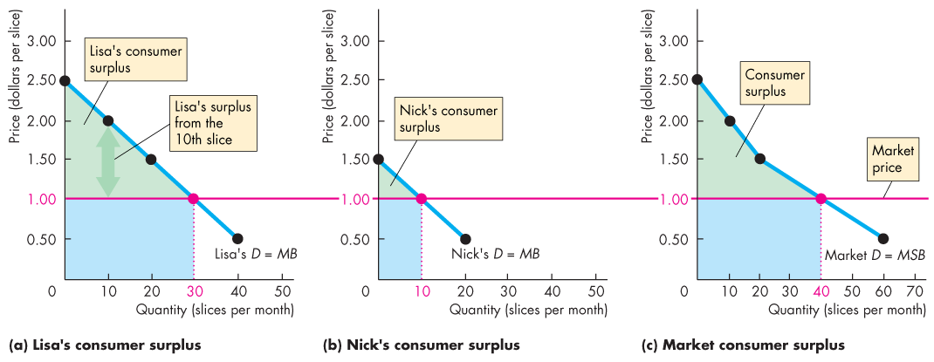
Benefit, Cost, and Surplus (12 of 25)
At $1 a slice, Lisa spends $30, Nick spends $10, and together they spend $40 on pizza.
The consumer surplus is the value from pizza in excess of the expenditure on it.

Slide 24
Benefit, Cost, and Surplus (13 of 25)
Supply and Marginal Cost
Firms are in business to make a profit.
To make a profit, firms must sell their output for a price that exceeds the cost of production.
Firms distinguish between cost and price.

Slide 25
Benefit, Cost, and Surplus (14 of 25)
Supply, Cost, and Minimum Supply-Price
Cost is what the producer gives up, price is what the producer receives.
The cost of one more unit of a good or service is its marginal cost.
Marginal cost is the minimum price that a firm is willing to accept.
But the minimum supply-price determines supply.
A supply curve is a marginal cost curve.

Slide 26
Benefit, Cost, and Surplus (15 of 25)
Individual Supply and Market Supply
The relationship between the price of a good and the quantity supplied by one producer is called individual supply.
The relationship between the price of a good and the quantity supplied by all producers in the market is called market supply.
Figure 5.3 on the next slide shows the connection between individual supply and market supply.

Slide 27
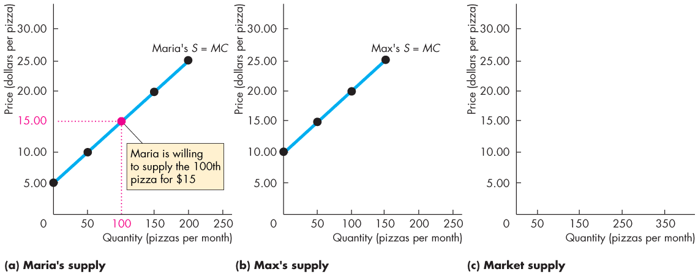
Benefit, Cost, and Surplus (16 of 25)
Maria and Max are the only producers of pizza.
At $15 a pizza, the quantity supplied by Maria is 100 pizzas.

Slide 28
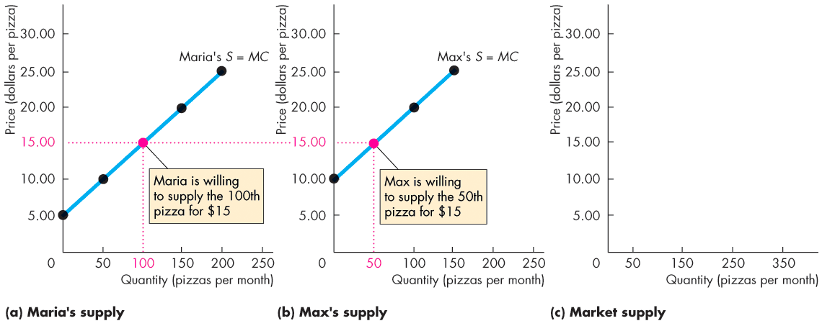
Benefit, Cost, and Surplus (17 of 25)
Maria and Max are the only producers of pizza.
At $15 a pizza, the quantity supplied by Max is 50 pizzas.

Slide 29
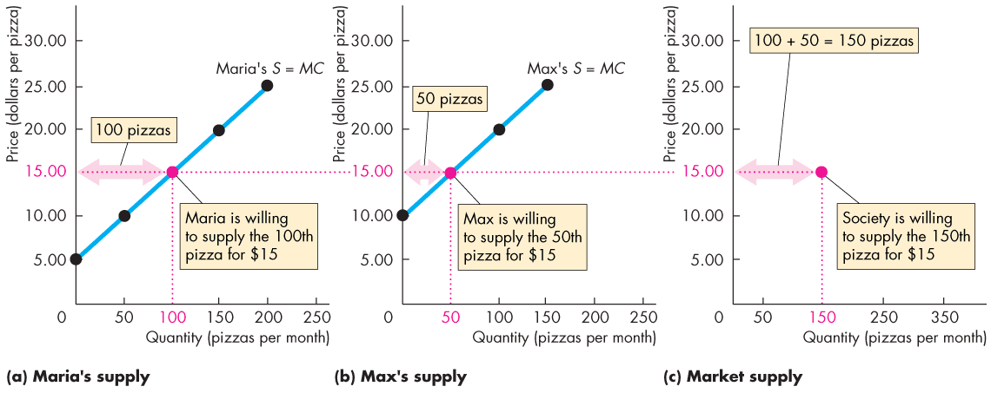
Benefit, Cost, and Surplus (18 of 25)
At $15 a pizza, the quantity supplied by Maria is 100 pizzas and by Max is 50 pizzas.
The quantity supplied by all producers is 150 pizzas.

Slide 30
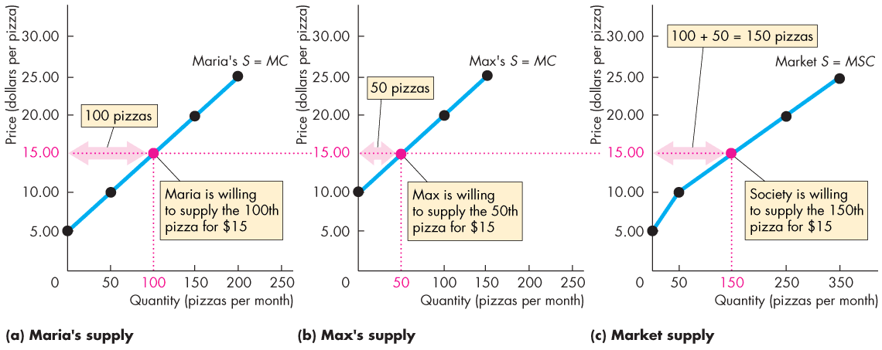
Benefit, Cost, and Surplus (19 of 25)
The market supply curve is the horizontal sum of the individual supply curves.

Slide 31
Benefit, Cost, and Surplus (20 of 25)
Producer Surplus
Producer surplus is the excess of the amount received from the sale of a good over the cost of producing it.
We calculate it as the price received for a good minus the minimum-supply price (marginal cost), summed over the quantity sold.
On a graph, producer surplus is shown by the area below the market price and above the supply curve, summed over the quantity sold.
Figure 5.4 on the next slide shows the producer surplus from pizza when the market price is $15 a pizza.
Notes:
A similar issue about the shapes of the areas arises here too. You might want to emphasize that the total revenue of the producer is the rectangle whose corners are (0, 0) and (P, Q). This total revenue divides into cost and producer surplus and the supply = marginal cost curve marks the boundary for the division.
The issue is not likely to arise at this point in the course, but you might like to keep up your sleeve for later the relationship between producer surplus and economic profit. The textbook doesn’t spend any time on this relationship because for most students, it is too esoteric. But a few thoughtful students want to know. You can explain that producer surplus = total revenue minus total variable cost; economic profit = total revenue minus total cost; so producer surplus = economic profit plus total fixed cost. Don’t try to explain this now. Wait until you get a question when you’re in Chapter 9, 10, 11, or 12.

Slide 32
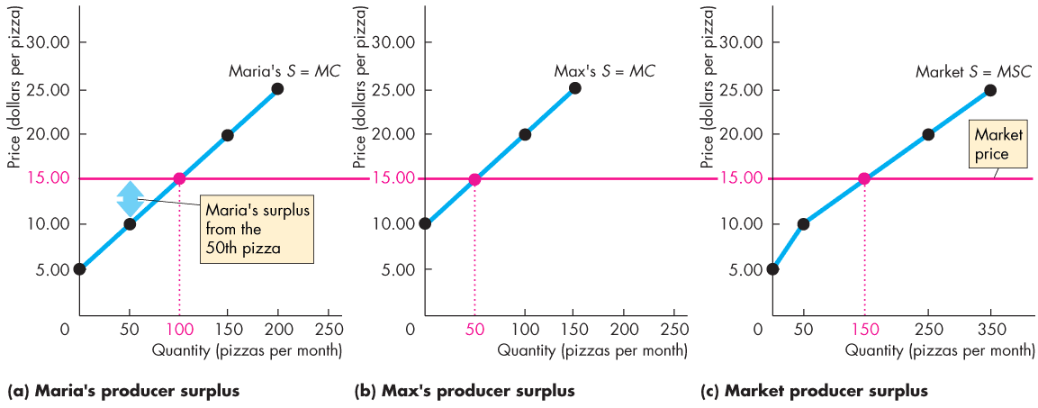
Benefit, Cost, and Surplus (21 of 25)
The market price of a pizza is $15 and Maria is willing to produce the 50th pizza for $10.
Maria’s surplus from the 50th pizza is the price minus the marginal cost, which is $5.

Slide 33
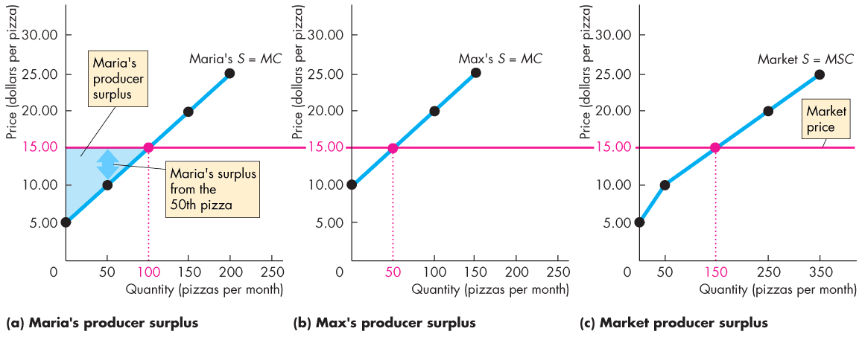
Benefit, Cost, and Surplus (22 of 25)
At $15 a pizza, Maria sells 100 pizzas.
So her producer surplus is the area of the blue triangle.

Slide 34
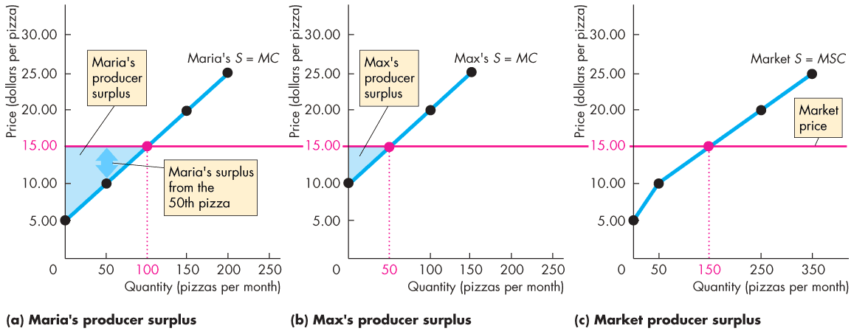
Benefit, Cost, and Surplus (23 of 25)
At $15 a pizza, Max sells 50 pizzas.
So his producer surplus is the area of the blue triangle.

Slide 35
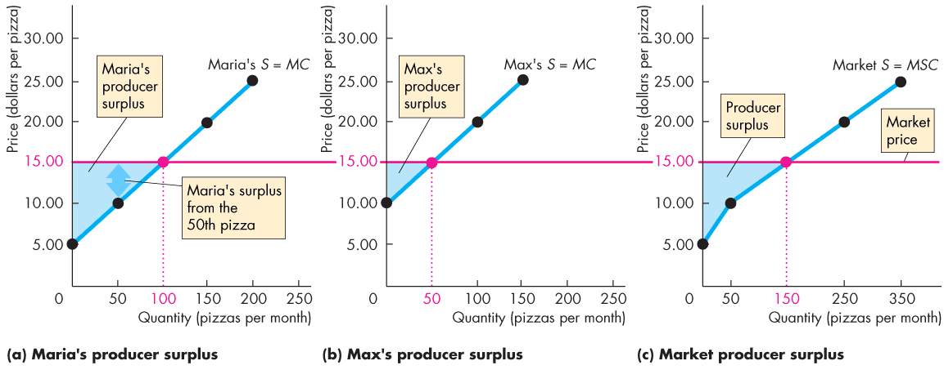
Benefit, Cost, and Surplus (24 of 25)
At $15 a pizza, the producer surplus for the economy is the area under the market price above the market supply curve, summed over the 150 pizzas sold.

Slide 36
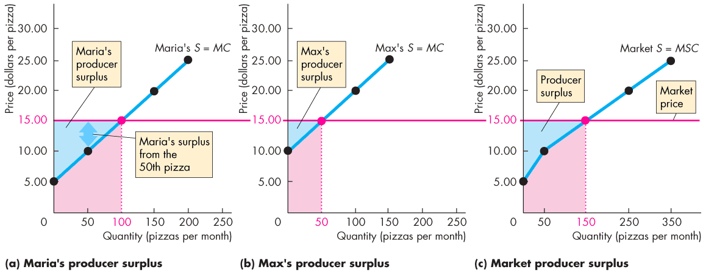
Benefit, Cost, and Surplus (25 of 25)
The red areas show the cost of producing the pizzas sold.
The producer surplus is the value of the pizza sold in excess of the cost of producing it.

Slide 37
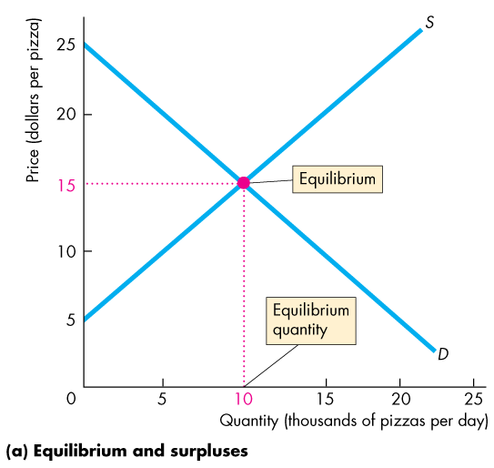
Is the Competitive Market Efficient? (1 of 18)
Efficiency of Competitive Equilibrium
Figure 5.5 shows that a competitive market creates an efficient allocation of resources at equilibrium.
In equilibrium, the quantity demanded equals the quantity supplied.
Notes:
Although done just with words and a diagram, this section explains the astonishing so-called “first fundamental theorem of welfare economics” that under appropriate conditions, competitive equilibrium is Pareto efficient (what this textbook calls an efficient allocation). You might want to provide your students with more background to this astonishing result. It begins with Adam Smith’s invisible hand conjecture. Some progress was made by Vilfredo Pareto (1848–1923), an Italian economist (see http://cepa.newschool.edu/het/profiles/pareto.htm), who defined an efficient allocation as one in which it is not possible to rearrange the use of resources and make someone better off without making someone else worse off. But Adam Smith’s conjecture did not receive formal proof until the 1950s. John Hicks, Kenneth Arrow, and Gerard Debreu are credited with the major contributions to welfare economics and received the Nobel Prize in Economic Sciences for their work (see http://www.nobel.se/economics/laureates/1972/index.html, http://www.nobel.se/economics/laureates/1983/index.html). Lionel McKenzie (University of Rochester) is also credited with a major independent statement of the theorem and some economists refer to it as the Arrow-Debreu-McKenzie theorem.
Continued on the notes page 44

Slide 38
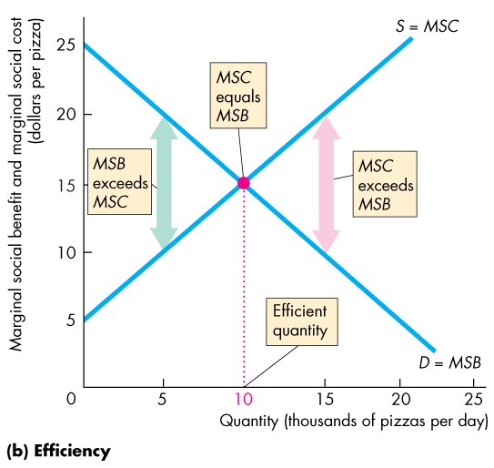
Is the Competitive Market Efficient? (2 of 18)
When production is …
less than the equilibrium quantity, MSB > MSC.
greater than the equilibrium quantity, MSC > MSB.
equal to the equilibrium quantity, MSC = MSB.
Notes:
The A-D-M proof is deeper and more restricted that the arm waving words and diagrams of a principles text. But we do not mislead our students by being enthusiastic and amazed at the astonishing proposition. Selfish people all pursuing their own ends and making themselves as well off as possible end up allocating resources in such a way that no one can be made better off (qualified by the exceptions that we quickly note in the chapter.)
Don’t get hung up on the mechanics of how the obstacles to efficiency work. Just note at this stage that they bring either underproduction or overproduction and emphasize the deadweight loss that they generate. You will go into the details in later chapters. The list is a guide to what is coming.
In the overproduction case, you might like to bring the PPF back into the story and point out that the overproduction of one good means the underproduction of some other good. If you’re brave, you might want to explain that in the two-goods world of the PPF, you get the complete efficiency analysis by looking at only one of the markets. If you use guns and butter again, the overproduction of guns implies the underproduction of butter. You can measure the deadweight loss in either the market for guns (overproduction like Figure 5.6b) or in the market for butter (underproduction like Figure 5.6a). Make this extension only with bright students in an honors section.

Slide 39
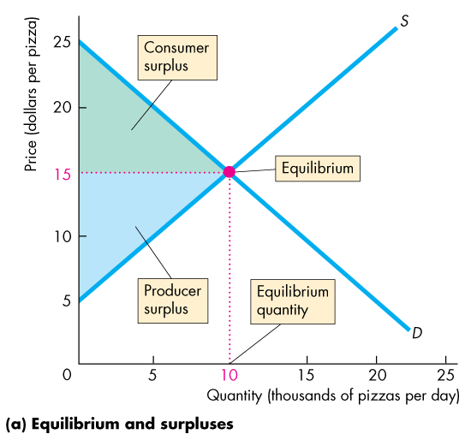
Is the Competitive Market Efficient? (3 of 18)
Resources are used efficiently when marginal social benefit equals marginal social cost.
When the efficient quantity is produced, total surplus (the sum of consumer surplus and producer surplus) is maximized.

Slide 40
Is the Competitive Market Efficient? (4 of 18)
The Invisible Hand
Adam Smith’s “invisible hand” idea in the Wealth of Nations implied that competitive markets send resources to their highest valued use in society.
Consumers and producers pursue their own self-interest and interact in markets.
Market transactions generate an efficient—highest valued—use of resources.
Notes:
Classroom activity
Check out Economics in Action: Seeing the Invisible Hand

Slide 41
Is the Competitive Market Efficient? (5 of 18)
Market Failure
Markets don’t always achieve an efficient outcome.
Market failure arises when a market delivers an inefficient outcome.
Market failure can occur because
Too little of an item is produced (underproduction) or
Too much of an item is produced (overproduction).
Notes:
Don’t get hung up on the mechanics of market failure. Just note at this stage that they bring either underproduction or overproduction and emphasize the deadweight loss that they generate. You will go into the details in later chapters. The list is a guide to what is coming.

Slide 42
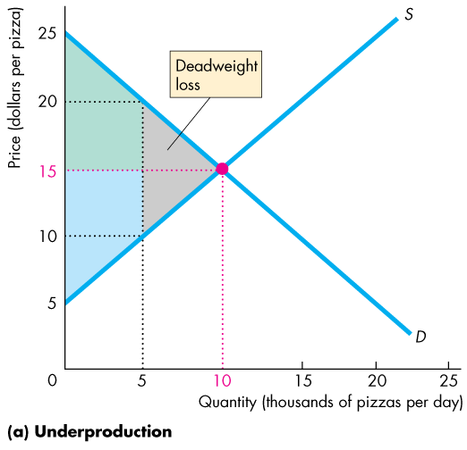
Is the Competitive Market Efficient? (6 of 18)
Underproduction
The efficient quantity is 10,000 pizzas a day.
If production is restricted to 5,000 pizzas a day, there is underproduction and the quantity is inefficient.
A deadweight loss equals the decrease in total surplus—the gray triangle.
This loss is a social loss.

Slide 43
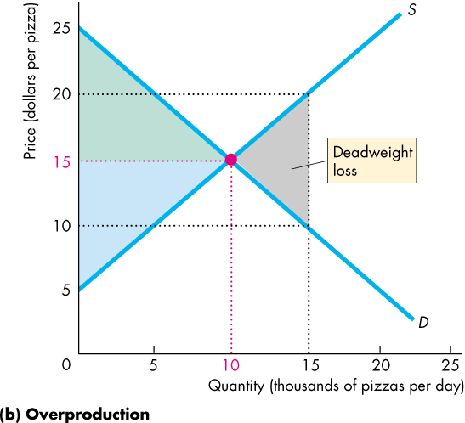
Is the Competitive Market Efficient? (7 of 18)
Overproduction
Again, the efficient quantity is 10,000 pizzas a day.
If production is expanded to 15,000 pizzas a day, a deadweight loss arises from overproduction.
This loss is a social loss.
Notes:
Classroom activity
Check out Economics in the News: Making Traffic Flow Efficiently

Slide 44
Is the Competitive Market Efficient? (8 of 18)
Sources of Market Failure
In competitive markets, underproduction or overproduction arise when there are
Price and quantity regulations
Taxes and subsidies
Externalities
Public goods and common resources
Monopoly
High transactions costs

Slide 45
Is the Competitive Market Efficient? (9 of 18)
Price and Quantity Regulations
Price regulations sometimes put a block on the price adjustments and lead to underproduction.
Quantity regulations that limit the amount that a farm is permitted to produce also lead to underproduction.

Slide 46
Is the Competitive Market Efficient? (10 of 18)
Taxes and Subsidies
Taxes increase the prices paid by buyers and lower the prices received by sellers.
So taxes decrease the quantity produced and lead to underproduction.
Subsidies lower the prices paid by buyers and increase the prices received by sellers.
So subsidies increase the quantity produced and lead to overproduction.

Slide 47
Is the Competitive Market Efficient? (11 of 18)
Externalities
An externality is a cost or benefit that affects someone other than the seller or the buyer of a good.
An electric utility creates an external cost by burning coal that creates acid rain.
The utility doesn’t consider this cost when it chooses the quantity of power to produce. Overproduction results.

Slide 48
Is the Competitive Market Efficient? (12 of 18)
An apartment owner would provide an external benefit if she installed an smoke detector.
But she doesn’t consider her neighbor’s marginal benefit and decides not to install a smoke detector.
The result is underproduction.

Slide 49
Is the Competitive Market Efficient? (13 of 18)
Public Goods and Common Resources
A public good benefits everyone and no one can be excluded from its benefits.
It is in everyone’s self-interest to avoid paying for a public good (called the free-rider problem), which leads to underproduction.

Slide 50
Is the Competitive Market Efficient? (14 of 18)
A common resource is owned by no one but can be used by everyone.
It is in everyone’s self interest to ignore the costs of their own use of a common resource that fall on others (called tragedy of the commons).
The tragedy of the commons leads to overproduction.

Slide 51
Is the Competitive Market Efficient? (15 of 18)
Monopoly
A monopoly is a firm that is the sole provider of a good or service.
The self-interest of a monopoly is to maximize its profit. To do so, a monopoly sets a price to achieve its self-interested goal.
As a result, a monopoly produces too little and underproduction results.

Slide 52
Is the Competitive Market Efficient? (16 of 18)
High Transactions Costs
Transactions costs are the opportunity cost of making trades in a market.
To use the market price as the allocator of scarce resources, it must be worth bearing the opportunity cost of establishing a market.
Some markets are just too costly to operate.
When transactions costs are high, the market might underproduce.

Slide 53
Is the Competitive Market Efficient? (17 of 18)
Alternatives to the Market
When a market is inefficient, can one of the non-market methods of allocation do a better job?
Often, majority rule might be used.
But majority rule has its own shortcomings. A group that pursues the self-interest of its members can become the majority.
Also, with majority rule, votes must be translated into actions by bureaucrats who have their own agendas.

Slide 54
Is the Competitive Market Efficient? (18 of 18)
There is no one efficient mechanism for allocating resources efficiently.
But supplemented majority rule, bypassed inside firms by command systems, and occasionally using first-come, first-served, markets do an amazingly good job.

Slide 55
Is the Competitive Market Fair? (1 of 7)
Ideas about fairness can be divided into two groups:
It’s not fair if the result isn’t fair.
It’s not fair if the rules aren’t fair.
Notes:
You could spend the rest of the course talking about and discussing equity, fairness, or distributive justice as it is sometimes called.
This material is not standard and you’ll be hard pressed to find it in any other principles text. It is included here because students are very curious about what is fair. And the news media writes and talks of little else when it discusses economic issues.
Some years ago, Jim Tobin told Michael Parkin a nice test of whether a person is a liberal or a conservative. It also generates a good classroom discussion. Here’s how it goes. Give the students the following scenario and question: You are at an oasis in a large desert and you have some ice cream in an unmovable refrigerator. (Ice cream is the only food available). The people in the next oasis some miles away have no ice cream (and no other food) and are too old and infirm to travel. You have plenty of ice cream and you can transport it to the next oasis, but on the journey, some of it will melt. Now the question: How much of the ice cream would have to survive the journey for it to be worth transporting to the next oasis?
Your students will not agree. The most liberal would transport if only the smallest percentage survived the journey. The most conservative would want a large proportion to survive before undertaking the redistribution.
You can point out that different people choose different points on the big tradeoff.

Slide 56
Is the Competitive Market Fair? (2 of 7)
It’s Not Fair if the Result Isn’t Fair
The idea that only equality brings efficiency is called utilitarianism.
Utilitarianism is the principle that states that we should strive to achieve “the greatest happiness for the greatest number.”

Slide 57
Is the Competitive Market Fair? (3 of 7)
If everyone gets the same marginal utility from a given amount of income, and
if the marginal benefit of income decreases as income increases,
then taking a dollar from a richer person and giving it to a poorer person increases the total benefit.
Only when income is equally distributed has the greatest happiness been achieved.

Slide 58
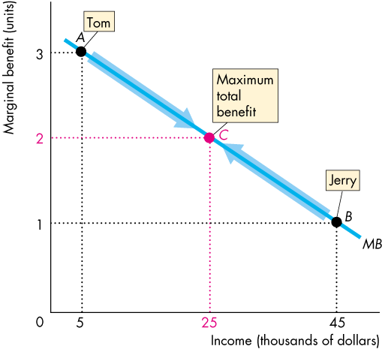
Is the Competitive Market Fair? (4 of 7)
Figure 5.7 shows how redistribution increases efficiency.
Tom is poor and has a high marginal benefit of income.
Jerry is rich and has a low marginal benefit of income.
Taking dollars from Jerry and giving them to Tom until they have equal incomes increases total benefit.

Slide 59
Is the Competitive Market Fair? (5 of 7)
The Big Tradeoff
Utilitarianism ignores the cost of making income transfers.
Recognizing these costs leads to the big tradeoff between efficiency and fairness.
Because of the big tradeoff, John Rawls proposed that income should be redistributed to the point at which the poorest person is as well off as possible.

Slide 60
Is the Competitive Market Fair? (6 of 7)
It’s Not Fair If the Rules Aren’t Fair
The idea that “it’s not fair if the rules aren’t fair” is based on the symmetry principle.
The symmetry principle is the requirement that people in similar situations be treated similarly.

Slide 61
Is the Competitive Market Fair? (7 of 7)
In economics, this principle means equality of opportunity, not equality of income.
Robert Nozick suggested that fairness is based on two rules:
The state must create and enforce laws that establish and protect private property.
Private property may be transferred from one person to another only by voluntary exchange.
This means that if resources are allocated efficiently, they may also be allocated fairly.
Notes:
Classroom activity
Check out At Issue: Price Gouging

