Slide 1
ECONOMICS
Twelfth Edition, Global Edition
Chapter 4
Elasticity

Slide 2
Chapter Outline and Learning Objectives
4.1 Define, calculate, and explain the factors that influence the price elasticity of demand
4.2 Define, calculate, and explain the factors that influence the income elasticity of demand and the cross elasticity of demand
4.3 Define, calculate, and explain the factors that influence the elasticity of supply
Notes:
Notes and teaching tips: 5, 12, 14, 19, 20, 22, 36, 37, 40, and 45.
To advance to the next slide, click anywhere on the full screen figure.
Applying the principles of economics to interpret and understand the news is a major goal of the principles course. You can encourage your students in this activity by using the two features: Economics in the News and Economics in Action.
(1) Before each class, scan the news and select two or three headlines that are relevant to your session today. There is always something that works. Read the headline and ask for comments, interpretation, discussion. Pose questions arising from it that motivate today’s class. At the end of the class, return to the questions and answer them with the tools you’ve been explaining.
(2) Once or twice a semester, set an assignment, for credit, with the following instructions:
(a) Find a news article about an economic topic that you find interesting.
(b) Make a short bullet-list summary of the article.
(c) Write and illustrate with appropriate graphs an economic analysis of the key points in the article.
Use the Economics in the News features in your textbook as models.

Slide 3
Price Elasticity of Demand (1 of 33)
You know that when supply decreases, the equilibrium price rises and the equilibrium quantity decreases.
But does the price rise by a large amount and the quantity decrease by a little?
Or does the price barely rise and the quantity decrease by a large amount?
The answer depends on the responsiveness of the quantity demanded of a good to a change in its price.

Slide 4
Price Elasticity of Demand (2 of 33)
You might think about the responsiveness of the quantity demanded of a good to a change in its price in terms of the slope of the demand curve.
If the demand curve is steep, the price rises by a lot; if the demand curve is almost flat, the price barely rises.
But the slope of a demand curve depends on the units in which we measure the price and the quantity. We can choose these units to make the demand curve steep or flat.
To measure responsiveness we need a measure that is independent of units of measurement.
Elasticity is such a measure.

Slide 5
Price Elasticity of Demand (3 of 33)
The price elasticity of demand is a units-free measure of the responsiveness of the quantity demanded of a good to a change in its price when all other influences on buying plans remain the same.
Calculating Price Elasticity of Demand
The price elasticity of demand is calculated by using the formula:
Notes:
Percentages and percentage changes. Many students need a refresher and some practice at doing what seems too simple to bother with, calculating percentages and percentage changes. Don’t be afraid to start with this pre-elasticity warm up. Just toss out some numbers. Suppose that the campus bookstore increases the price of an economics text from $70 to $80. What is the percentage increase in price? Suppose the campus computer store lowers the price of an iMac from $1500 to $1000. What is the percentage decrease in price?
Next, tell them the prices have moved in the opposite directions: The campus book store cuts the price of an economics text from $80 to $70. What is the percentage decrease in price? And the campus computer store now raises the price of an iMac from $1000 to $1500. What is the percentage increase in price?
You’re now all set to get the students using the average of the original and new price to calculate percentages that are independent of the direction of change.
Many students have a hard time remembering whether quantity or price goes in the numerator of the elasticity formulas. Have the students create their own mnemonic. Suggest McDonald’s Big Mac™ hamburgers. It’s silly, but it works, reminding the student that Q (quantity) appears before P (price) in the ratio of percentage changes.
For practice at calculating the price elasticity of demand, bring out your demand schedule for Coke (or other drink) that you sold in class when you covered demand. Get the students to calculate the price elasticity of demand at various points along that demand curve.

Slide 6
Price Elasticity of Demand (4 of 33)
To calculate the price elasticity of demand:
We express the change in price as a percentage of the average price—the average of the initial and new price, …
and we express the change in the quantity demanded as a percentage of the average quantity demanded—the average of the initial and new quantity.

Slide 7
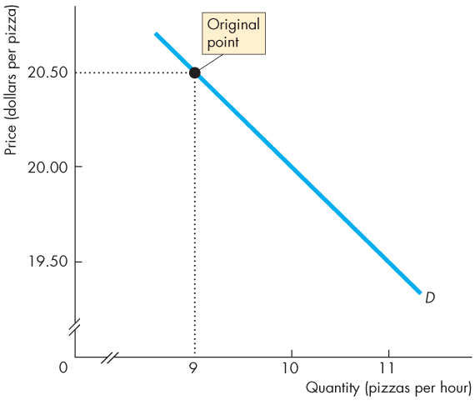
Price Elasticity of Demand (5 of 33)
Figure 4.1 calculates the price elasticity of demand for pizza.
Initially, the price of a pizza is $20.50 and the quantity demanded is 9 pizzas an hour.

Slide 8
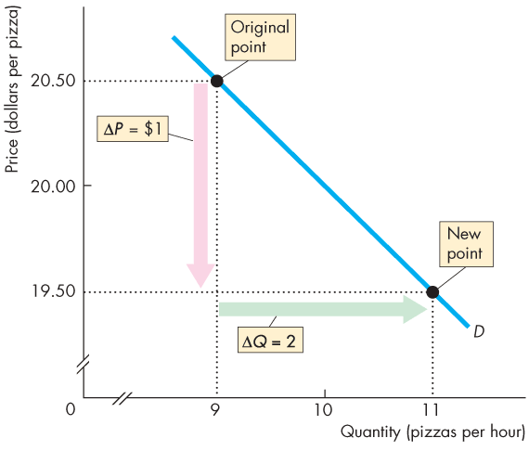
Price Elasticity of Demand (6 of 33)
The price of a pizza falls to $19.50 and the quantity demanded increases to 11 pizzas an hour.
The price falls by $1 and the quantity demanded increases by 2 pizzas an hour.

Slide 9
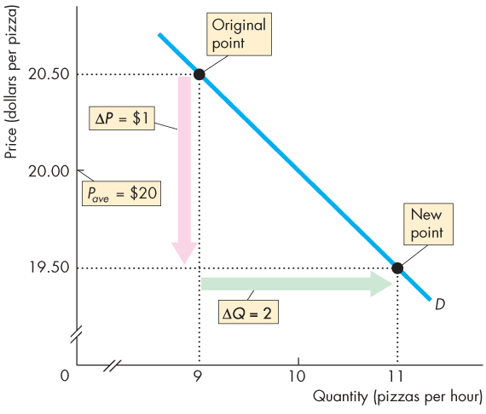
Price Elasticity of Demand (7 of 33)
The average price is $20 and the average quantity demanded is 10 pizzas an hour.

Slide 10
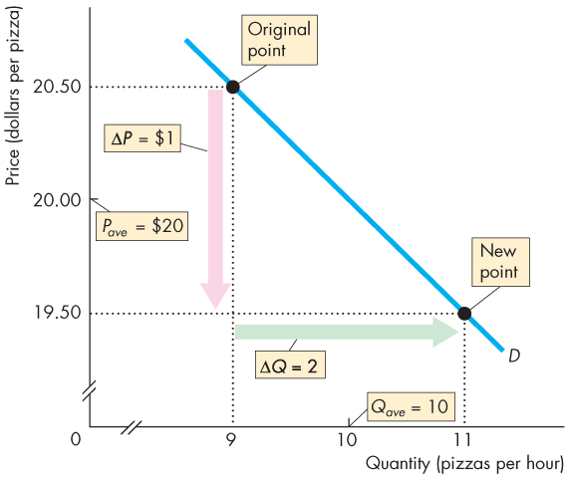
Price Elasticity of Demand (8 of 33)
The percentage change in quantity demanded, %ΔQ, is calculated as ΔQ/Q_{ave} x 100, which is
(2/10) x 100 = 20%.
The percentage change in price, %ΔP, is calculated as ΔP/P_{ave} x 100, which is
($1/$20) x 100 = 5%.

Slide 11
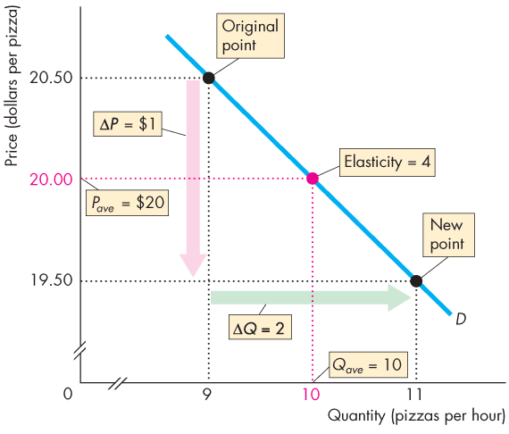
Price Elasticity of Demand (8 of 33)
The price elasticity of demand is %ΔQ / %ΔP = 20% / 5%
= 4.

Slide 12
Price Elasticity of Demand (9 of 33)
Average Price and Quantity
By using the average price and average quantity, we get the same elasticity value regardless of whether the price rises or falls.
Percentages and Proportions
The ratio of two proportionate changes is the same as the ratio of two percentage changes.
%ΔQ / %ΔP = ΔQ / ΔP
Notes:
Classroom activity
Check out Economics in the News: The Elasticity of Demand for Peanut Butter
Check out Economics in the News: The Elasticity of Demand for Coffee

Slide 13
Price Elasticity of Demand (10 of 33)
A Units-Free Measure
Elasticity is a ratio of percentages, so a change in the units of measurement of price or quantity leaves the elasticity value the same.
Minus Sign and Elasticity
The formula yields a negative value, because price and quantity move in opposite directions.
But it is the magnitude, or absolute value, that reveals how responsive the quantity change has been to a price change.

Slide 14
Price Elasticity of Demand (11 of 33)
Inelastic and Elastic Demand
Demand can be inelastic, unit elastic, or elastic, and can range from zero to infinity.
If the quantity demanded doesn’t change when the price changes, the price elasticity of demand is zero and the good has a perfectly inelastic demand.
Notes:
Classroom activity
Check out Economics in Action: Elastic and Inelastic Demand

Slide 15
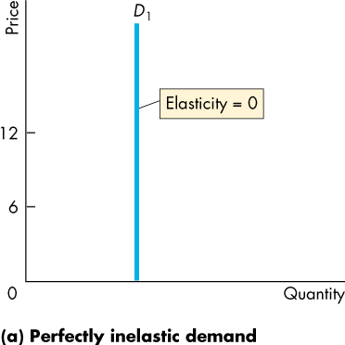
Price Elasticity of Demand (12 of 33)
Figure 4.2(a) illustrates the case of a good that has a perfectly inelastic demand.
The demand curve is vertical.

Slide 16
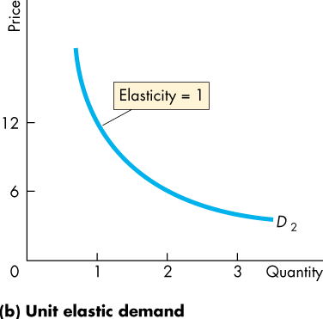
Price Elasticity of Demand (13 of 33)
If the percentage change in the quantity demanded equals the percentage change in price, …
the price elasticity of demand equals 1 and the good has unit elastic demand.
Figure 4.2(b) illustrates this case—a demand curve with ever declining slope.

Slide 17
Price Elasticity of Demand (14 of 33)
If the percentage change in the quantity demanded is smaller than the percentage change in price,
the price elasticity of demand is less than 1 and the good has inelastic demand.
If the percentage change in the quantity demanded is greater than the percentage change in price,
the price elasticity of demand is greater than 1 and the good has elastic demand.

Slide 18
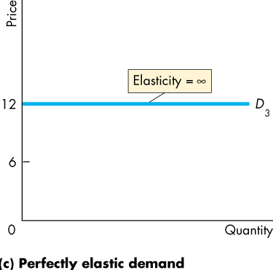
Price Elasticity of Demand (15 of 33)
If the percentage change in the quantity demanded is infinitely large when the price barely changes, …
the price elasticity of demand is infinite and the good has a perfectly elastic demand.
Figure 4.2(c) illustrates the case of perfectly elastic demand—a horizontal demand curve.

Slide 19
Price Elasticity of Demand (16 of 33)
The Factors That Influence the Elasticity of Demand
The elasticity of demand for a good depends on:
The closeness of substitutes
The proportion of income spent on the good
The time elapsed since a price change
Notes:
Fuel for thought: Getting some intuition on what determines whether demand is inelastic or elastic
The demand for gasoline and junk food in general. Students love their cars and junk food, and they know that the demand for both in general is inelastic because there are no good substitutes for personal transportation and a quick snack.
The demand for Joe’s quick-mart gasoline. Ask your students if Joe’s quick-mart (substitute your actual local one) convenience store would lose much business and total revenues if he raised the price of gasoline more than a penny or two compared to the other three gas stations at a street intersection. When the students conclude he’d lose much of his gasoline sales ask them to reconcile this large quantity decrease to a small increase in price (elastic demand) with the fact that they earlier stated that demand for gasoline is very inelastic. They will recognize that gasoline from other corner stations is a very good substitute for Joe’s gasoline.
The demand for Joe’s quick-mart junk food. After students recognize that abundant substitute availability keeps elasticity high, ask the students why Joe’s junk food (and all quick-mart stores’ junk food) is priced so much higher than the near-by grocery store’s junk food. Students will conclude that “convenience” stores are well named. Most people aren’t willing to wait in the grocery store check-out line behind the frazzled mother of three screaming kids, each hanging on the over-loaded basket that will take 15 minutes of coupon validating and price checking to check out. The grocery store is not a good substitute for people on the go looking for a fast snack and a quick gas fill.

Slide 20
Price Elasticity of Demand (17 of 33)
Closeness of Substitutes
The closer the substitutes for a good or service, the more elastic is the demand for the good or service.
Necessities, such as food or housing, generally have inelastic demand.
Luxuries, such as exotic vacations, generally have elastic demand.
Notes:
Classroom activity
Check out Economics in Action: Price Elasticity of Demand for Food

Slide 21
Price Elasticity of Demand (18 of 33)
Proportion of Income Spent on the Good
The greater the proportion of income consumers spend on a good, the larger is the elasticity of demand for that good.
Time Elapsed Since Price Change
The more time consumers have to adjust to a price change, or the longer that a good can be stored without losing its value, the more elastic is the demand for that good.

Slide 22
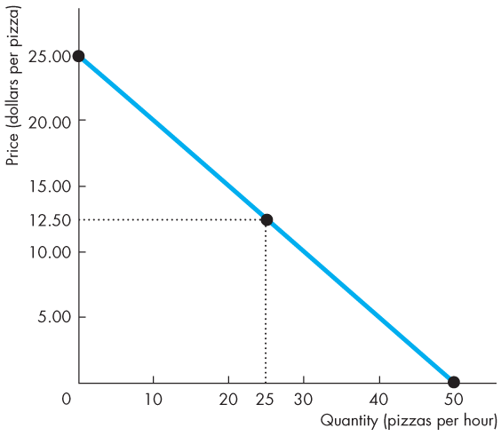
Price Elasticity of Demand (19 of 33)
Elasticity Along a Linear Demand Curve
Figure 4.3 shows how the elasticity of demand changes along a linear demand curve.
At the mid-point of the demand curve, demand is unit elastic.
Notes:
Elasticity and slope along a linear demand curve. You can provide solid intuition on why the elasticity of demand falls as we move down a linear demand curve. Point out first that as the quantity increases, the percentage change in quantity decreases for equal changes in quantity. Do two calculations, one at a small quantity and one at a large quantity. Then point out that this same reasoning applies to the price. As the price falls, the percentage change in price increases for equal changes in price. Again, do two calculations, one at a high price and one at a low price. Now put the two together. As we move downward along the demand curve, the percentage change in quantity is getting smaller and the percentage change in price is getting larger, so the elasticity—the ratio of the percentage change in quantity to the percentage change in price—is getting smaller.

Slide 23
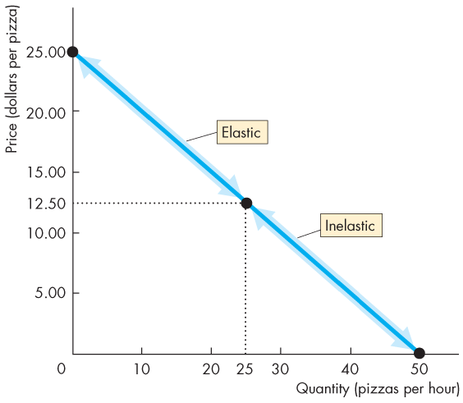
Price Elasticity of Demand (20 of 33)
At prices above the mid-point of the demand curve, demand is elastic.
At prices below the mid-point of the demand curve, demand is inelastic.

Slide 24
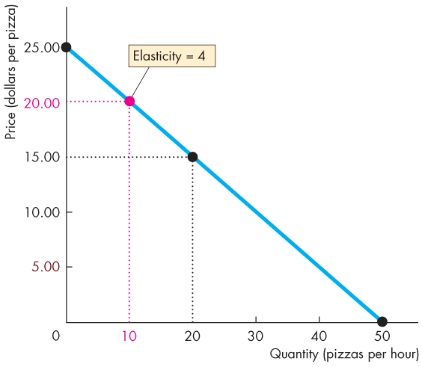
Price Elasticity of Demand (21 of 33)
For example, if the price falls from $25 to $15, the quantity demanded increases from 0 to 20 pizzas an hour.
The average price is $20 and the average quantity is 10 pizzas.
The price elasticity of demand is (20/10) divided by (10/20), which equals 4.

Slide 25
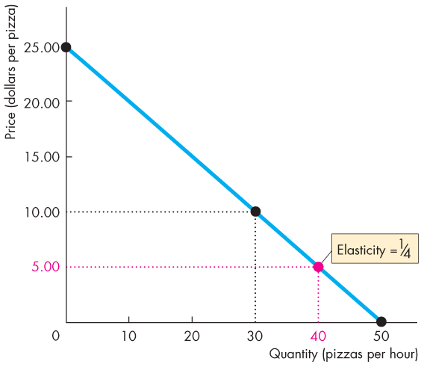
Price Elasticity of Demand (22 of 33)
If the price falls from $10 to $0, the quantity demanded increases from 30 to 50 pizzas an hour.
The average price is $5 and the average quantity is 40 pizzas.
The price elasticity is (20/40) divided by (10/5), which equals 1/4.

Slide 26
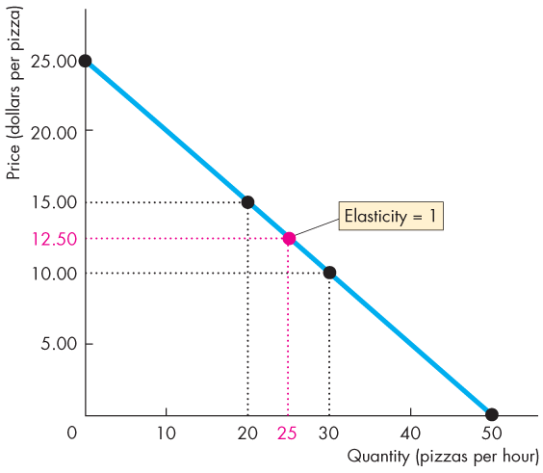
Price Elasticity of Demand (23 of 33)
If the price falls from $15 to $10, the quantity demanded increases from 20 to 30 pizzas an hour.
The average price is $12.50 and the average quantity is 25 pizzas.
The price elasticity is (10/25) divided by (5/12.5), which equals 1.

Slide 27
Price Elasticity of Demand (24 of 33)
Total Revenue and Elasticity
The total revenue from the sale of a good or service equals the price of the good multiplied by the quantity sold.
When the price changes, total revenue also changes.
But a rise in price doesn’t always increase total revenue.

Slide 28
Price Elasticity of Demand (25 of 33)
The change in total revenue due to a change in price depends on the elasticity of demand:
If demand is elastic, a 1 percent price cut increases the quantity sold by more than 1 percent, and total revenue increases.
If demand is inelastic, a 1 percent price cut increases the quantity sold by less than 1 percent, and total revenues decreases.
If demand is unit elastic, a 1 percent price cut increases the quantity sold by 1 percent, and total revenue remains unchanged.

Slide 29
Price Elasticity of Demand (26 of 33)
The total revenue test is a method of estimating the price elasticity of demand by observing the change in total revenue that results from a price change (when all other influences on the quantity sold remain the same).
If a price cut increases total revenue, demand is elastic.
If a price cut decreases total revenue, demand is inelastic.
If a price cut leaves total revenue unchanged, demand is unit elastic.

Slide 30
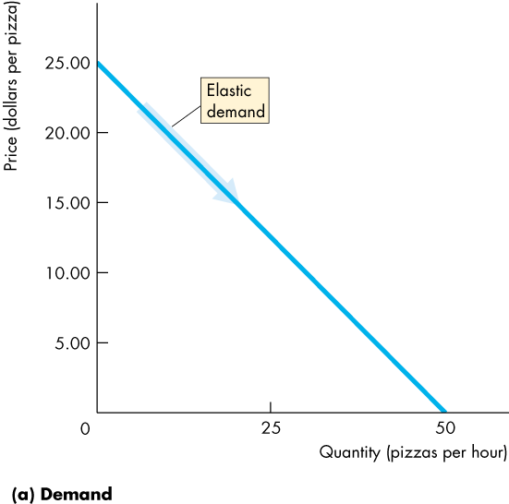
Price Elasticity of Demand (27 of 33)
Figure 4.4 shows the relationship between elasticity of demand and the total revenue.
As the price of a pizza falls from $25 to $12.50, the quantity demanded increases from 0 to 25 pizzas an hour.
Demand is elastic, and total revenue increases.

Slide 31
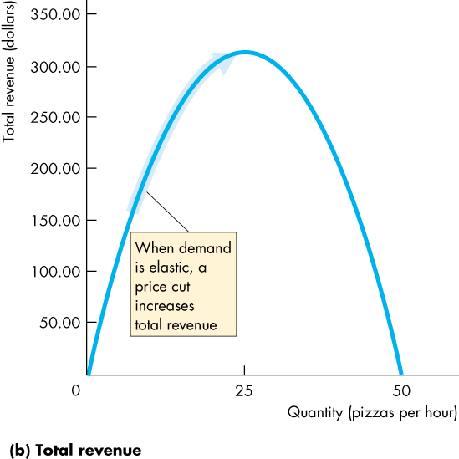
Price Elasticity of Demand (28 of 33)
In part (b), as the quantity increases from 0 to 25 pizzas an hour, demand is elastic, and total revenue increases.

Slide 32
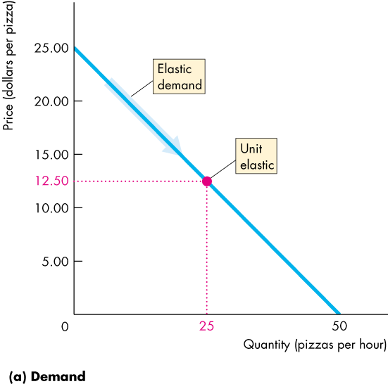
Price Elasticity of Demand (29 of 33)
At $12.50 a pizza, demand is unit elastic and total revenue stops increasing.

Slide 33
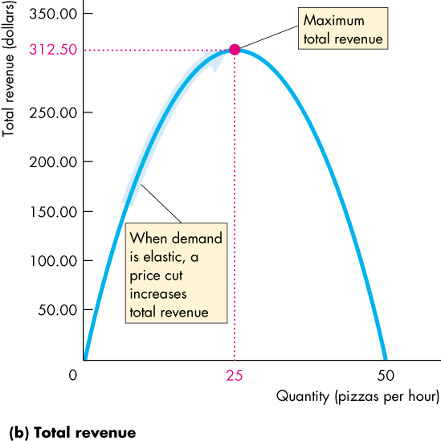
Price Elasticity of Demand (30 of 33)
At 25 pizzas an hour, demand is unit elastic, and total revenue is at its maximum.

Slide 34
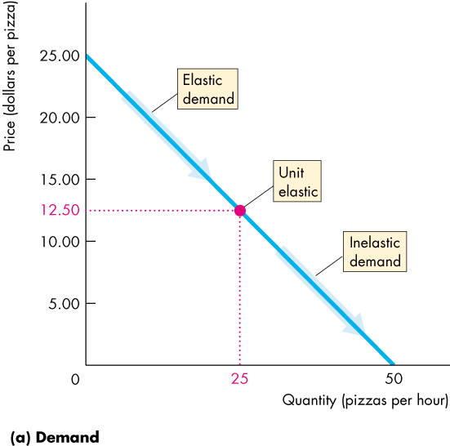
Price Elasticity of Demand (31 of 33)
As the price of a pizza falls from $12.50 to zero, the quantity demanded increases from 25 to 50 pizzas an hour.
Demand is inelastic, and total revenue decreases.

Slide 35
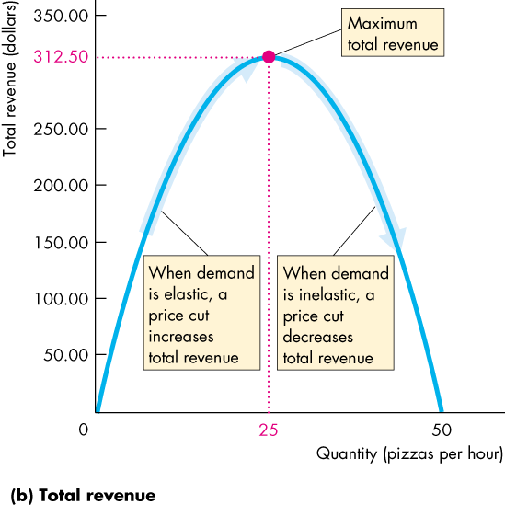
Price Elasticity of Demand (32 of 33)
As the quantity increases from 25 to 50 pizzas an hour, demand is inelastic, and total revenue decreases.

Slide 36
Price Elasticity of Demand (33 of 33)
Your Expenditure and Your Elasticity
If your demand is elastic, a 1 percent price cut increases the quantity you buy by more than 1 percent and your expenditure on the item increases.
If your demand is inelastic, a 1 percent price cut increases the quantity you buy by less than 1 percent and your expenditure on the item decreases.
If your demand is unit elastic, a 1 percent price cut increases the quantity you buy by 1 percent and your expenditure on the item does not change.
Notes:
Encourage your students to use the total revenue test (total expenditure) to check whether their demand for some item the price of which has changed, is elastic or inelastic.

Slide 37
More Elasticities of Demand (1 of 5)
Income Elasticity of Demand
The income elasticity of demand measures how the quantity demanded of a good responds to a change in income, other things remaining the same.
The formula for calculating the income elasticity of demand is
Notes:
Classroom activity
Check out Economics in the News: More Peanut Butter Demand Elasticities
Check out Economics in Action: Necessities and Luxuries

Slide 38
More Elasticities of Demand (2 of 5)
If the income elasticity of demand is greater than 1, demand is income elastic and the good is a normal good.
If the income elasticity of demand is greater than zero but less than 1, demand is income inelastic and the good is a normal good.
If the income elasticity of demand is less than zero (negative) the good is an inferior good.

Slide 39
More Elasticities of Demand (3 of 5)
Cross Elasticity of Demand
The cross elasticity of demand is a measure of the responsiveness of demand for a good to a change in the price of a substitute or a complement, other things remaining the same.
The formula for calculating the cross elasticity is:

Slide 40
More Elasticities of Demand (4 of 5)
The cross elasticity of demand for
a substitute is positive.
a complement is negative.
Notes:
Emphasize the information content in the algebraic sign of the cross elasticity and the income elasticity and contrast this situation with the price elasticity for which we focus only on the magnitude and not the sign.

Slide 41
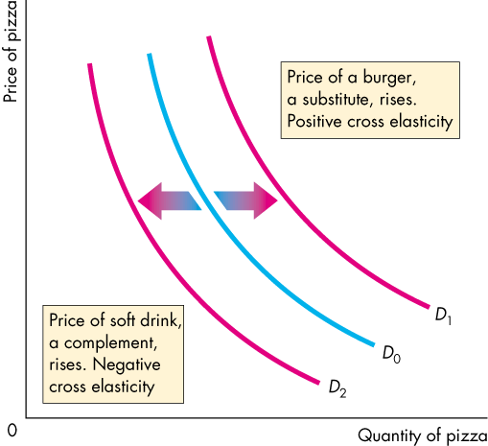
More Elasticities of Demand (5 of 5)
Figure 4.5 shows the increase in the quantity of pizza demanded when the price of a burger (a substitute for pizza) rises.
The figure also shows the decrease in the quantity of pizza demanded when the price of a soft drink (a complement of pizza) rises.

Slide 42
Elasticity of Supply (1 of 6)
You know that when the demand for a good increases, its equilibrium price rises and the equilibrium quantity of the good increases.
But does the price rise by a large amount and the quantity increase by a little?
Or does the price barely rise and the quantity increase by a large amount?
The answer depends on the responsiveness of the quantity supplied of a good to a change in its price.
The answer depends on the elasticity of supply of the good.

Slide 43
Elasticity of Supply (2 of 6)
The elasticity of supply measures the responsiveness of the quantity supplied to a change in the price of a good, when all other influences on selling plans remain the same.
Calculating the Elasticity of Supply
The elasticity of supply is calculated by using the formula:

Slide 44
Elasticity of Supply (3 of 6)
Figure 4.6 on the next slide shows three cases of the elasticity of supply.
Supply is perfectly inelastic if the supply curve is vertical and the elasticity of supply is 0.
Supply is unit elastic if the supply curve is linear and passes through the origin. (Note that slope is irrelevant.)
Supply is perfectly elastic if the supply curve is horizontal and the elasticity of supply is infinite.

Slide 45
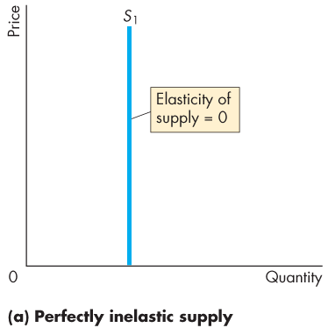
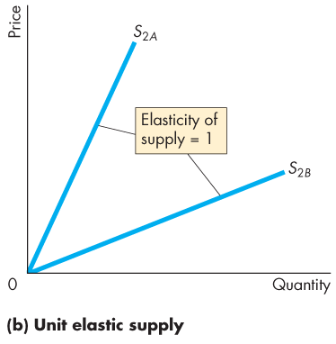
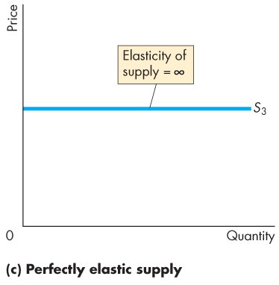
Elasticity of Supply (4 of 6)
Notes:
The unit elastic demand curve is a good one to use to emphasize that elasticity and slope are not equal. Have the students calculate the elasticity of supply on two linear demand curves that passes through the origin, one with a slope of 0.5 and the other with a slope of 2. They’ll get the message.

Slide 46
Elasticity of Supply (5 of 6)
The Factors That Influence the Elasticity of Supply
The elasticity of supply depends on
Resource substitution possibilities
Time frame for supply decision
Resource Substitution Possibilities
The easier it is to substitute among the resources used to produce a good or service, the greater is its elasticity of supply.

Slide 47
Elasticity of Supply (6 of 6)
Time Frame for Supply Decision
The more time that passes after a price change, the greater is the elasticity of supply.
Momentary supply is perfectly inelastic. The quantity supplied immediately following a price change is constant.
Short-run supply is somewhat elastic.
Long-run supply is the most elastic.

Slide 48
Glossary of Elasticities (1 of 4)
Table 4.1 provides a glossary of all the elasticity measures.
TABLE 4.1 | A Compact Glossary of Elasticities
Price Elasticities of Demand A relationship is described as |  | When its magnitude is | Which means that
Perfectly elastic |  | Less than infinity | The smallest possible increase in price causes an infinitely large decrease in the quantity demanded*
Elastic |  | Less than infinity | The percentage decrease in the quantity demanded exceeds the percentage increase in price
Unit elastic |  | 1 | The Percentage decrease in the quantity demanded equals the percentage increase in price
Inelastic |  | Less than 1 but greater than zero | The percentage decrease in the quantity demanded is less than the percentage increase in price
Perfectly inelastic |  | Zero | The quantity demanded is the same at all prices

Slide 49
Glossary of Elasticities (2 of 4)
TABLE 4.1 | A Compact Glossary of Elasticities
Cross Elasticities of Demand A Relationship is described as |  | When its value is | Which means that
Close substitutes |  | Large | The smallest possible increase in the price of one good causes an infinitely large increase in the quantity demanded* of the other good
Substitutes |  | Positive | If the price of one good increase, the quantity demanded of the other good also increases
Unrelated goods |  | Zero | If the price of one good increases, the quantity demanded of the other good remains the same
Complements |  | Negative | If the price of one good increases, the quantity demanded of the other good decreases

Slide 50
Glossary of Elasticities (3 of 4)
TABLE 4.1 | A Compact Glossary of Elasticities
Income Elasticities of Demand A Relationship is described as |  | When its value is | Which Means that
Income elastic (normal good) |  | Greater than 1 | The percentage increase in the quantity demanded is greater than the percentage increase in income*
Income elastic (normal good) |  | Less than 1 but greater than zero | The percentage increase in the quantity demanded is greater than zero but less than the percentage increase in income
Negative (inferior good) |  | Less than zero | When income increases, quantity demanded decreases

Slide 51
Glossary of Elasticities (4 of 4)
TABLE 4.1 | A Compact Glossary of Elasticities
Elasticities of supply A relationship is described as |  | When its magnitude is | Which means that
Perfectly elastic |  | Infinity | The smallest possible increase in price causes an infinitely large increase in the quantity supplied*
Elastic |  | Less than infinity but greater than 1 | The percentage increase in the quantity supplied exceeds the percentage increase in the price
Unit elastic |  | 1 | The percentage increase in the quantity supplied equals the percentage increase in the price
Inelastic |  | Greater than zero but less than 1 | The percentage increase in the quantity supplied is less than the percentage increase in the price
Perfectly inelastic |  | Zero | The quantity supplied is the same at all prices
*In each description, the directions of change may be reversed. For example, in the perfectly elastic demand, the smallest possible decrease in price causes an infinitely large increase in the quantity demanded.

